Slide 1
Introduction of Calcium in Endocrinology and Bone Metabolism
Sonia Stanton
Endocrinologist
Canberra Hospital and Health Services

Slide 2
Calcium
The Element
Absorption
Compartments
Excretion
Function
Regulation and Endocrine control (PTH/ 1,25 (OH)₂ Vitamin D/ calcitonin)
Bone metabolism (hydroxyapatite)
Osteoporosis vs osteomalacia vs rickets

Slide 3
Learning Objectives
Understand how human body gains and loses calcium
Be able to outline the endocrine control of serum calcium
Understand the role of bone in calcium homeostasis
Understand the role of calcium in bone structure

Slide 4
Calcium “Ca”
From Latin word “calx” meaning lime (lime = calcium oxide)
Group 2 of periodic table (number 20/ alkaline earth element)
Reactive metal/ 2 electrons in outer shell/makes ionic bonds readily
5th most abundant element in the human body
  after oxygen, carbon, hydrogen and nitrogen
About 1-1.2kg in adult body
99% in bone and teeth

Slide 5
How does our body get Calcium ?
Food and water
  Dairy/ fortified soy products/bones/vegetables/supplements
  300mg calcium in 1 cup milk or 2 slices cheese or 200g yoghurt
Absorption
  Dissolves in the stomach
  2 methods of absorption in the small intestine
  Transcellular active transport process in duodenum and upper jejunum
  Paracellular passive process throughout the intestine

Slide 6
Calcium absorption
Phytic acid and oxalic acid bind calcium in GIT and reduce absorption
    High levels in spinach, collard greens, sweet potato, beans
Phosphate and soluble fibre also bind and reduce absorption
Coffee minimal reduction in calcium absorption (approx. 4mg per cup cf 300mg content of a cup of milk)
Percentage of calcium absorbed reduces as dose increases above 500mg in one event

Slide 7
Calcium -GIT
1000mg ingested in a day results in 400mg absorbed
200mg lost by intestinal secretions
200mg net absorption
(approx. 200mg lost in urine if in balance)

Slide 8
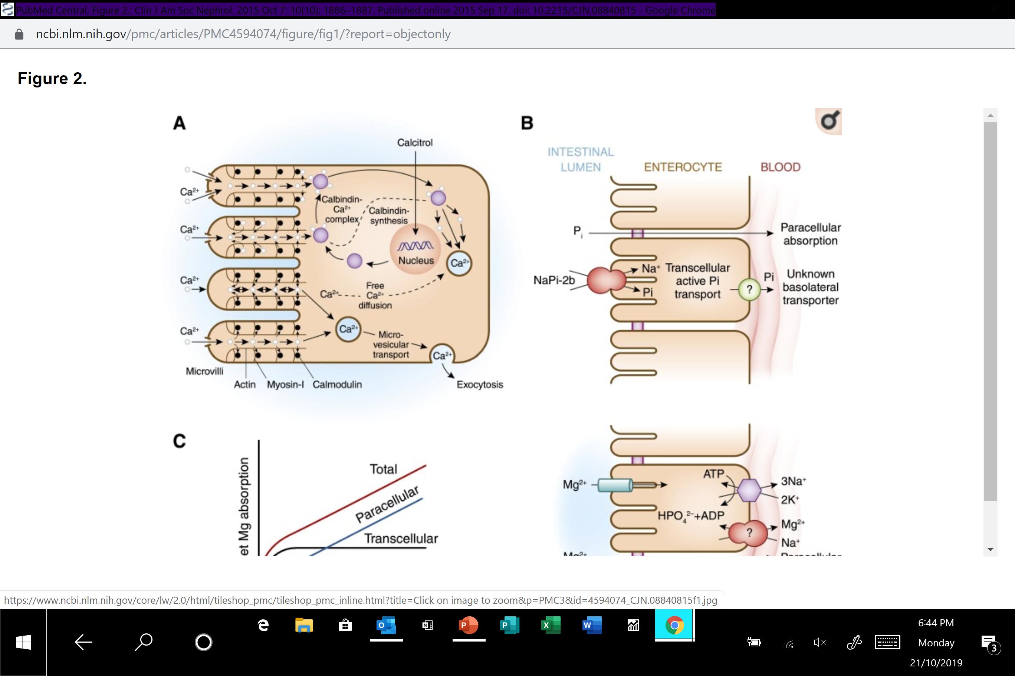
Intestinal Absorption

Slide 9
1,25 (OH)₂ Vitamin D
Indirectly affects paracellular (passive) absorption
  Activates protein kinase C which alters structure of intracellular tight junctions thereby increasing permeability to calcium
Main action by direct affect on active absorption (transcellular)
  Calcium moves down calcium concentration gradient via calcium channel into apical section of microvillae (passive)
  calcium rapidly/reversibly bound to calmodulin-actin-myosin 1 complex
  Moves to basolateral area by microvesicular transport
  Saturation of the complex reduces the calcium gradient and reduces calcium absorption but 1,25 (OH)₂ vit D upregulates synthesis of Calbindin which upload calcium-calmodulin complexes
  As calbindin-calcium complex dissociates the free intracellular calcium is extruded from cell by sodium-calcium exchanger

Slide 10
How does calcium get out of the body ?
Urine/faeces/sweat
Urine
  100-300mg/day (adult with normal renal function)
  Ultrafiltrate ionised and complexed calcium (not protein bound)
  10g calcium filtered per day (but only 0.1g in urine per day)
  98-99% reabsorbed
    60-70% in proximal convoluted tubule
    20% loop of Henle
    10% distal convoluted tubule
    5% collecting duct

Slide 11
Calcium- Renal handling
Proximal tubular reabsorption (60-70% of filtered calcium)
  80% passive/solvent drag
  Remaining active transport processes regulated by parathyroid hormone (PTH) and calcitonin
No calcium reabsorption in thin segment of Loop of Henle
Thick ascending limb (10% of filtered calcium)
  mostly passive absorption (paracellular) but calcium sensing receptor present in basolateral membrane influences permeability to calcium
  The small component active absorption is PTH and calcitonin sensitive
Distal tubule reabsorbs calcium only by transcellular route
  Distal convoluted tubule (10%)
  Collecting duct (5%)
  Only 15% of the filtered calcium but the major site for regulation

Slide 12
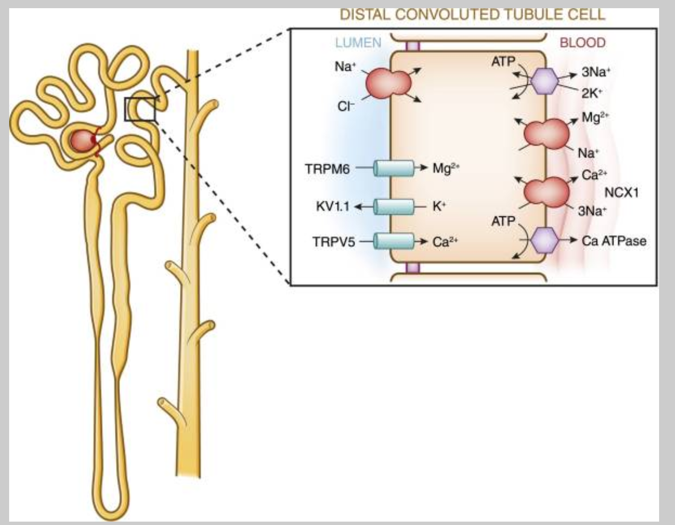
Calcium –Renal handling

Slide 13
Calcium losses
Faeces
  2.1mg/kg/day in adults
Sweat
  8-265 mg/L
  Profuse sweating average 20mg calcium/hour lost (6.2 mg/hr in comfortable environment)

Slide 14
Calcium -Distribution
Bone and teeth 99%
  1% freely exchangeable with calcium in extracellular compartment
Cell organelles 0.9% (mitochondria and endoplasmic reticulum)
  Intracellular signalling
  Enzyme activation
  Muscle contraction
Extracellular 0.1% (plasma)
  48% ionised, 46% protein bound, 7% complexed fractions
    Protein bound – albumin, globulins
    Complexed fractions bound to phosphate, citrate
  Ionised component tightly regulated

Slide 15
Plasma Calcium Regulation
pH
Parathyroid Hormone (PTH)
1,25 (OH)₂ Vitamin D
(Calcitonin)

Slide 16
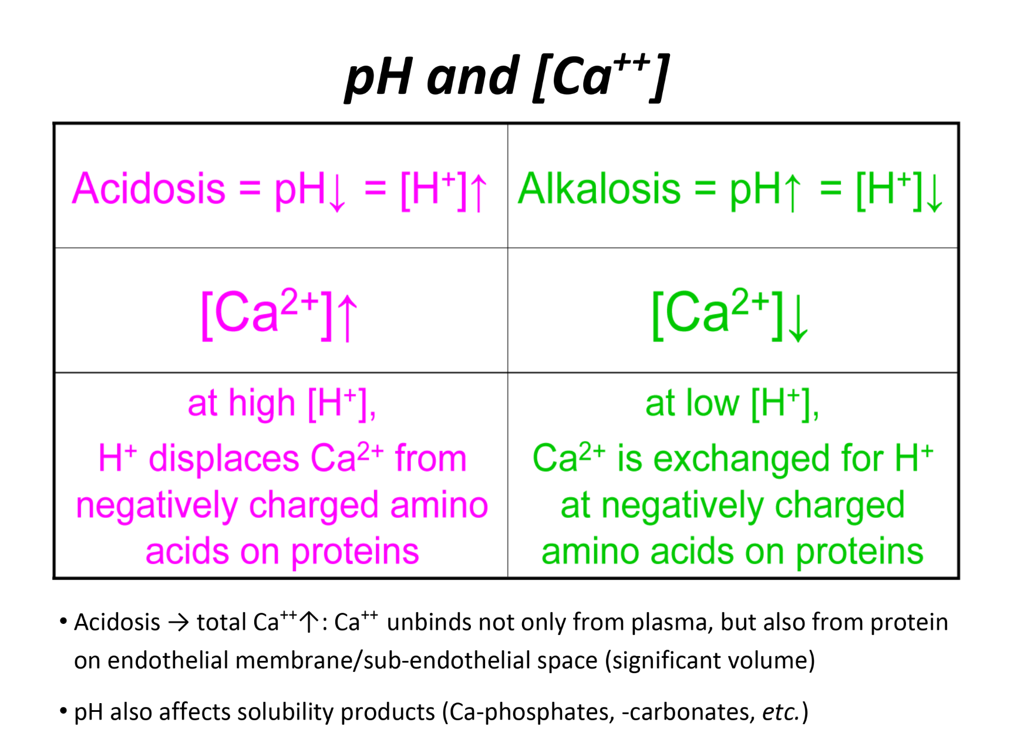
Rapid calcium change/ pH

Slide 17
Parathyroid Hormone
4 Parathyroid glands in neck (occas 5th)
High blood flow
Calcium sensing receptor
Secrete PTH in response to minor downward trend in serum calcium
PTH has direct effect on bone and kidney to resorb calcium
Indirect effect on GIT calcium absorption via upregulation 1,25 (OH)₂Vit D

Slide 18
Parathyroid Hormone
Kidney
  Increases calcium resorption at ascending Loop of Henle, distal convoluted tubule and collecting duct
Bone: Increases bone release of calcium in 2 ways
  Rapid phase within minutes- osteoblasts and osteocytes (overlie bone formation/bone fluid)
      PTH binds to receptors on these cells and the osteocytic membrane pumps calcium ions from bone fluid into extracellular fluid
  Slower phase over days – osteoclasts resorbing bone
      Mature osteoclasts do not have PTH receptors
      PTH stimulates differentiation of immature osteoclasts (they have both PTH and vitD receptors)

Slide 19
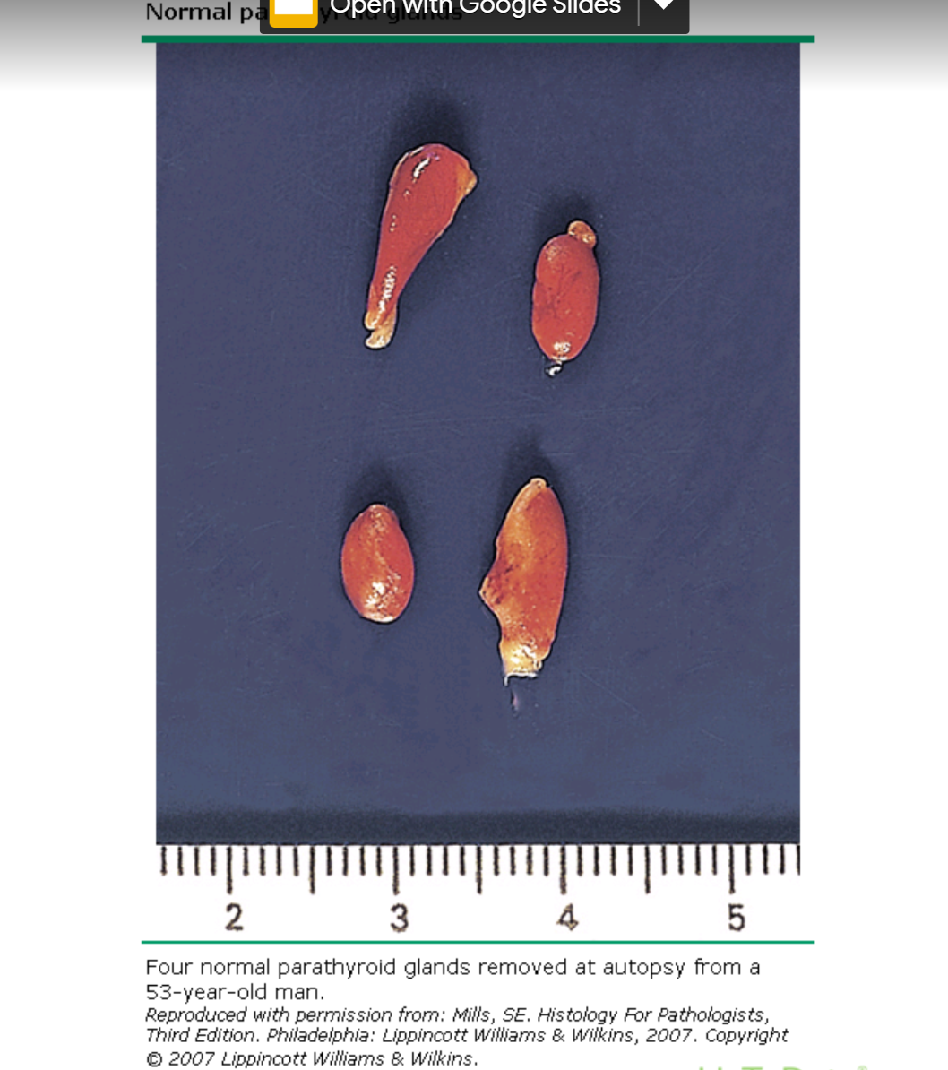
Parathyroid Glands

Slide 20
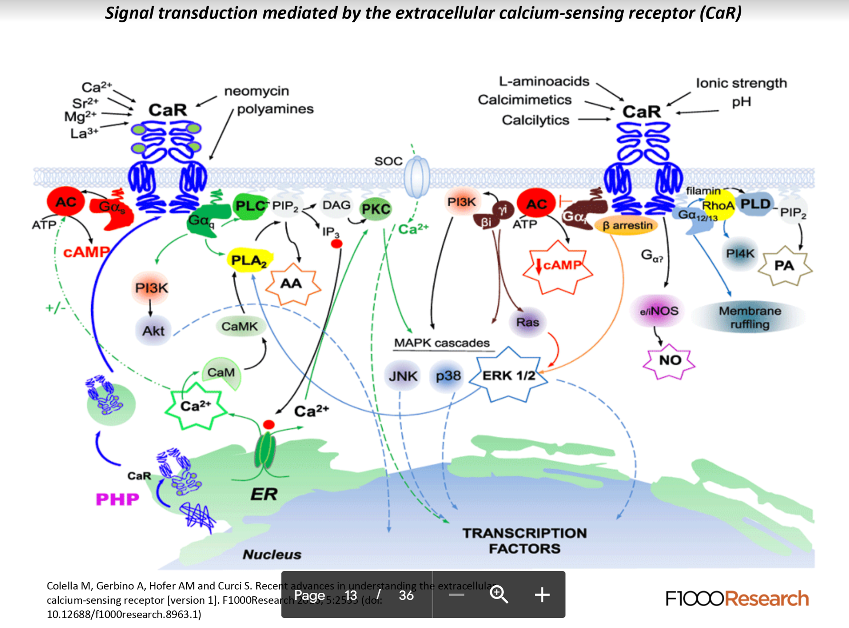
Calcium sensing receptor

Slide 21
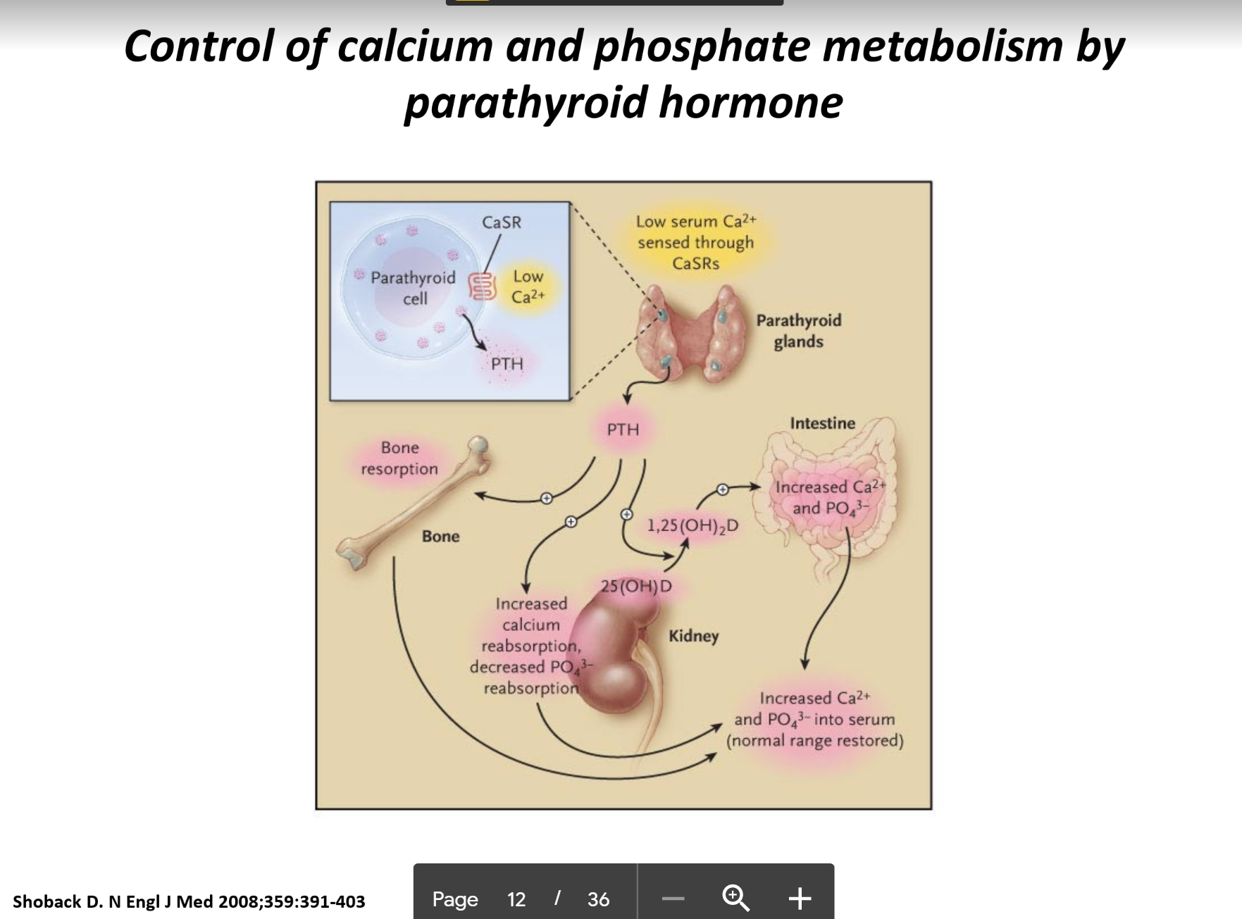
PTH regulation of Calcium

Slide 22
Vitamin D
7-dehydrocholesterol in skin plus UVB radiation (lower layers of epidermis)
  produces cholecalciferol (base vitamin D)
Cholecalciferol at liver plus 25-hydroxylase
  Produces 25 hydroxyvitamin D (25 OH VitD) – clinically measured more than 1,25 Vit D
25 OH vitamin D at kidney (and other sites) plus 1⍺ hydroxylase
  Produces 1,25 (OH)₂ Vitamin D - the potent form
Excess UVB induces enzymes that degrade cholecalciferol (prevents toxicity)

Slide 23
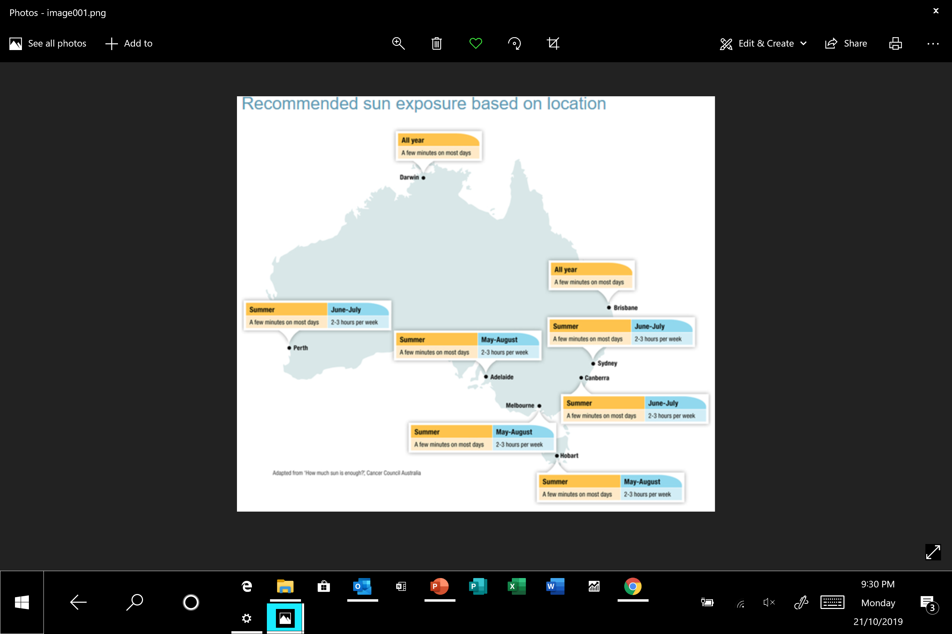
Vitamin D

Slide 24
1,25 (OH)₂ Vitamin D
1,25 (OH)₂ Vitamin D levels increased by PTH activating renal 1⍺-hydroxylase
  Synthesis at renal proximal tubule
  Action at distal tubules (plus bone and GIT)
1,25 (OH)₂ Vit D increases GIT Ca absorption (active and passive)
1,25 (OH)₂ Vit D increases bone resorption

Slide 25
Calcitonin
From thyroid parafollicular cells (cf follicular cells which make thyroid hormone)
In theory opposes PTH and reduces serum calcium by
  Inhibition of osteoclasts and therefore reduction bone resorption
  Reducing renal calcium resorption
However, no obvious clinical effect of excess/deficient calcitonin in humans

Slide 26
Bone Metabolism
Bone matrix (protein)
  predominantly type 1 collagen (also osteocalcin and osteopontin)
Hydroxyapatite (mineral)
  Ca₅(PO₄)₃(OH)
  Bone mineral 50% volume (70% weight) of bone
  Deposited in highly regulated manner into organic matrix
Osteoclasts
  derived from macrophages/ resorb bone
Osteoblasts
  mesenchymal derived/ form bone/ synthesise collagen and other proteins
  Organised connected groups of osteoblasts produce hydroxyapatite
Osteocytes
  Have mechanoreceptors used to coordinate bone repair

Slide 27
Bone Metabolism
Growing skeleton
  Longitudinal growth until epiphyses close from pubertal hormone exposure
  Continue to increase bone mass and accumulate calcium until age 30
  Peak bone mass age 30
Grown skeleton
  Slow bone loss after 30 (both matrix and mineral)
  Accelerated loss after menopause for approx. 10 years
  Accelerated loss with some illnesses and medications

Slide 28
Bone
Osteoporosis vs osteomalacia vs rickets
  Osteoporosis is reduced matrix and reduced mineral (matched) ie less bone
  Osteomalacia is reduced mineral but not reduced matrix ie unmineralised bone
  Rickets is unmineralised bone in growing bone (child)
    Usually bowing of weightbearing limbs

Slide 29
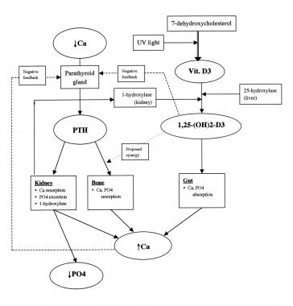
Summary

Slide 30
Clinical Journal of the American Society of Nephrology : CJASN
  Renal control of Calcium, Phosphate and Magnesium Homeostasis 2015

