Slide 1
Introduction of Calcium in Endocrinology and Bone Metabolism
Robert Schmidli
Endocrinologist, Canberra Hospital and Health Services
Clinical Senior Lecturer, ANU Medical School

Slide 2
Learning Objectives
Understand how human body gains and loses calcium
Be able to outline the endocrine control of serum calcium
Understand the role of bone in calcium homeostasis
Understand the role of calcium in bone structure
Understand hormonal and other control of calcium and bone metabolism

Slide 3
Case history
31 year-old public servant
Two episodes of sudden pain & popping sensation in knee
Walking down stairs
Getting into car
X-ray shows stress fracture of femur

Slide 4
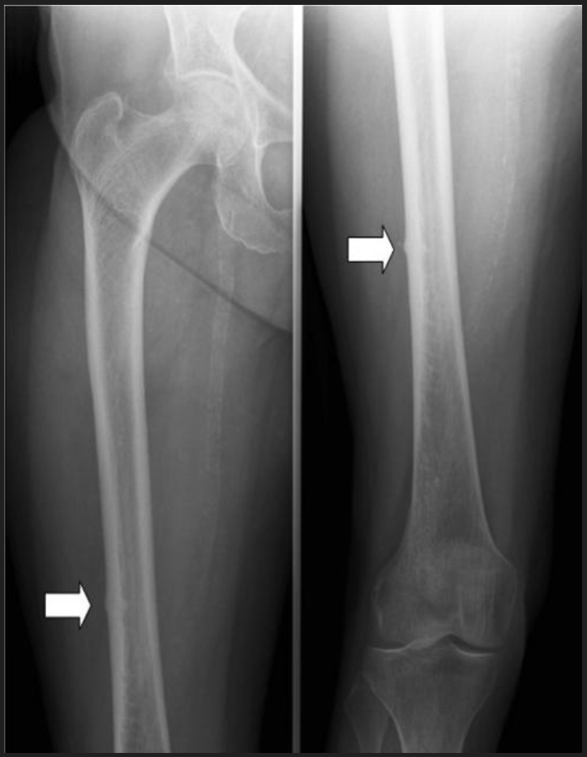

Slide 5
Other history
Fractured R base of thumb – fall on outstretched hand
No history of steroid therapy, prolonged immobilisation
Nonsmoker, no alcohol
Good energy, weight stable
Medications
Paracetamol/Codeine
Diclofenac (NSAID)

Slide 6
Examination
Appeared overweight
BP 120/70
Weight 106.2kg
Gynaecomastia – 2cm on left
Testicular volume 12ml
Visual fields normal
CVS, respiratory, GI systems normal

Slide 7
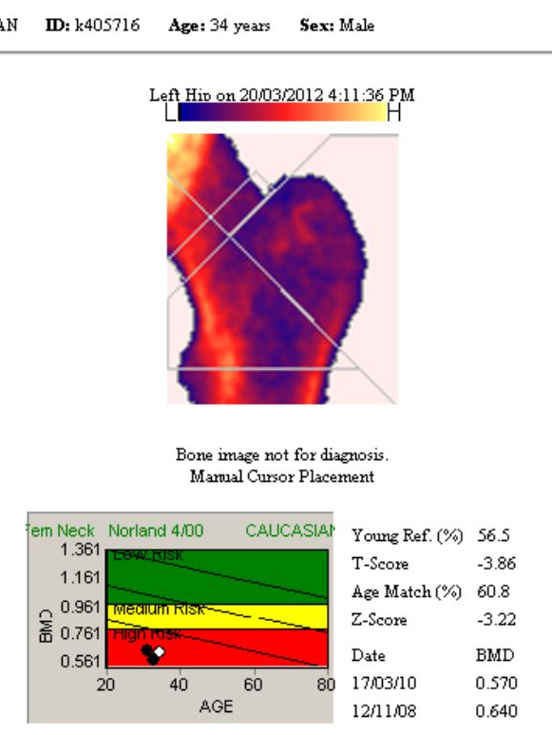
Bone density scan

Slide 8
Calcium

Slide 9
Calcium
The Element
Absorption
Compartments
Excretion
Function
Regulation and Endocrine control (PTH/ 1,25 (OH)₂ Vitamin D/ calcitonin)
Bone metabolism (hydroxyapatite)
Osteoporosis vs osteomalacia vs rickets

Slide 10
Calcium - Ca²⁺
From Latin word “calx” meaning lime (lime = calcium oxide)
Group 2 of periodic table (number 20/ alkaline earth element)
5th most abundant element in the human body
after oxygen, carbon, hydrogen and nitrogen
About 1-1.2kg in adult body
99% in bone and teeth

Slide 11
How does our body get Calcium ?
Food and water
Dairy/fortified foods/bones/vegetables/supplements
300mg calcium in 1 cup milk or 2 slices cheese or 200g yoghurt
Absorption
Dissolves in the stomach
2 methods of absorption in the small intestine
Transcellular active transport process in duodenum and upper jejunum
Paracellular passive process throughout the intestine
Recommended daily intake 1000-1300mg/day
More if pregnant or lactating

Slide 12
Calcium absorption
1000mg ingested in a day results in 200 - 400mg absorbed
Excess excreted in stool
Excess secreted in urine
Phytic acid and oxalic acid bind calcium in GIT and reduce absorption
High levels in spinach, collard greens, sweet potato, beans
Phosphate and soluble fibre also bind and reduce absorption
Percentage of calcium absorbed reduces as dose increases above 500mg in one event

Slide 13
1,25 (OH)₂ Vitamin D
Main action by direct effect on active absorption (transcellular)
Regulated by 1,25 (OH)₂ vit D (active form)
Extruded from cell by sodium-calcium exchanger
Indirectly affects paracellular (passive) absorption
Affects intracellular tight junctions thereby increasing permeability to calcium

Slide 14
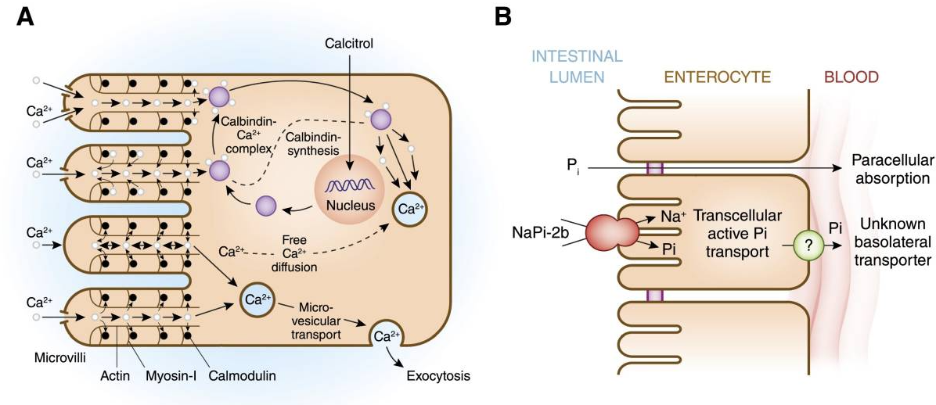
Intestinal Absorption
https://ncbi.nlm.nih.gov/pmc/articles/PMC4594074/

Slide 15
How does calcium get out of the body ?
Urine
100-300mg/day (adult with normal renal function)
10g calcium filtered per day (but only 0.1g in urine per day)
98-99% reabsorbed
60-70% in proximal convoluted tubule
Faeces
2.1mg/kg/day in adults
Sweat
8-265 mg/L
Profuse sweating average 20mg calcium/hour lost (6.2 mg/hr in comfortable environment)

Slide 16
Calcium -Distribution
Bone and teeth 99%
1% freely exchangeable with calcium in extracellular compartment
Cell organelles 0.9% (mitochondria and endoplasmic reticulum)
Intracellular signalling
Enzyme activation
Muscle contraction
Extracellular 0.1% (plasma)

Slide 17
Circulating calcium
Concentration 2.2 – 2.6 mmol/L
48% ionised, 46% protein bound, 7% complexed fractions
Protein bound – albumin, globulins
Complexed fractions bound to phosphate, citrate
Ionised (unbound) concentration critically important
Very tightly regulated
Hypocalcaemia: muscular spasms, seizures
Hypercalcaemia: nausea, vomiting etc
Protein bound – inert – mainly bound to albumin
Total calcium depends on protein/albumin concentration
Free fraction remains constant
Usually corrected for albumin concentration

Slide 18
Plasma Calcium Regulation
pH
Parathyroid Hormone (PTH)
1,25 (OH)₂ Vitamin D
(Calcitonin)

Slide 19
Rapid calcium change/ pH

Slide 20
Parathyroid Hormone
4 Parathyroid glands in neck (occas 5th)
High blood flow
Calcium sensing receptor
Secreted in response to minor downward trend in serum calcium
PTH has direct effect on bone and kidney to resorb calcium
Indirect effect on GIT calcium absorption via upregulation 1,25 (OH)₂Vit D

Slide 21
Parathyroid Hormone
Kidney
Increases calcium resorption at ascending Loop of Henle, distal convoluted tubule and collecting duct
Bone: Increases bone release of calcium in 2 ways
Rapid phase within minutes- osteoblasts and osteocytes (overlie bone formation/bone fluid)
PTH binds to receptors on these cells and the osteocytic membrane pumps calcium ions from bone fluid into extracellular fluid
Slower phase over days – osteoclasts resorbing bone
Mature osteoclasts do not have PTH receptors
PTH stimulates differentiation of immature osteoclasts (they have both PTH and vitD receptors)

Slide 22
Parathyroid Glands

Slide 23
PTH regulation of Calcium

Slide 24
Vitamin D

Slide 25
Vitamin D
7-dehydrocholesterol in skin plus UVB radiation (lower layers of epidermis)
produces cholecalciferol (base vitamin D)
Cholecalciferol at liver plus 25-hydroxylase
Produces 25 hydroxyvitamin D (25 OH VitD) – clinically measured more than 1,25 Vit D
25 OH vitamin D at kidney (and other sites) plus 1⍺ hydroxylase
Produces 1,25 (OH)₂ Vitamin D - the potent form
Excess UVB induces enzymes that degrade cholecalciferol (prevents toxicity)

Slide 26
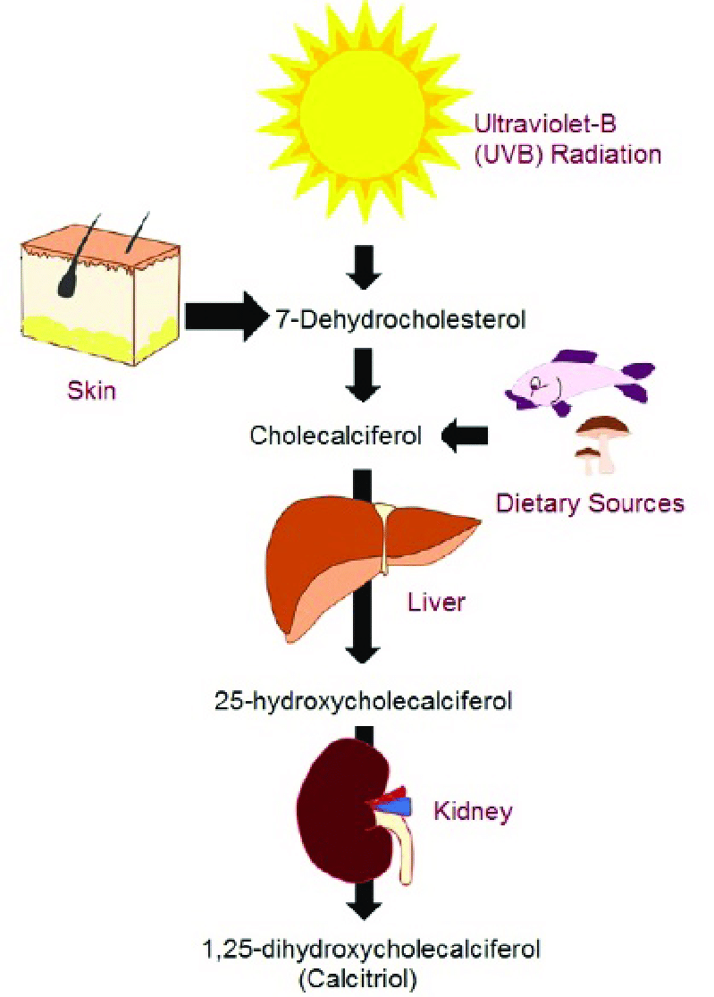
Vitamin D metabolism
https://www.researchgate.net/figure/Endogenous-and-exogenous-sources-of-vitamin-D-and-its-metabolic-activation_fig1_353742304

Slide 27
1,25 (OH)₂ Vitamin D
1,25 (OH)₂ Vitamin D levels increased by PTH activating renal 1⍺-hydroxylase
Synthesis at renal proximal tubule
Action at distal tubules (plus bone and GIT)
1,25 (OH)₂ Vit D increases GIT Ca absorption (active and passive)
1,25 (OH)₂ Vit D increases bone resorption

Slide 28
Vitamin D

Slide 29
Calcitonin
From thyroid parafollicular cells (cf follicular cells which make thyroid hormone)
In theory opposes PTH and reduces serum calcium by
Inhibition of osteoclasts and therefore reduction bone resorption
Reducing renal calcium resorption
However, no obvious clinical effect of excess/deficient calcitonin in humans

Slide 30
Bone metabolism

Slide 31
Bone Metabolism
Bone matrix (protein)
predominantly type 1 collagen (also osteocalcin and osteopontin)
Hydroxyapatite (mineral)
Ca₅(PO₄)₃(OH)
Bone mineral 50% volume (70% weight) of bone
Deposited in highly regulated manner into organic matrix
Osteoclasts
Derived from macrophages/ resorb bone
Osteoblasts
Mesenchymal derived/ form bone/ synthesise collagen and other proteins
Organised connected groups of osteoblasts produce hydroxyapatite
Osteocytes
Have mechanoreceptors used to coordinate bone repair

Slide 32
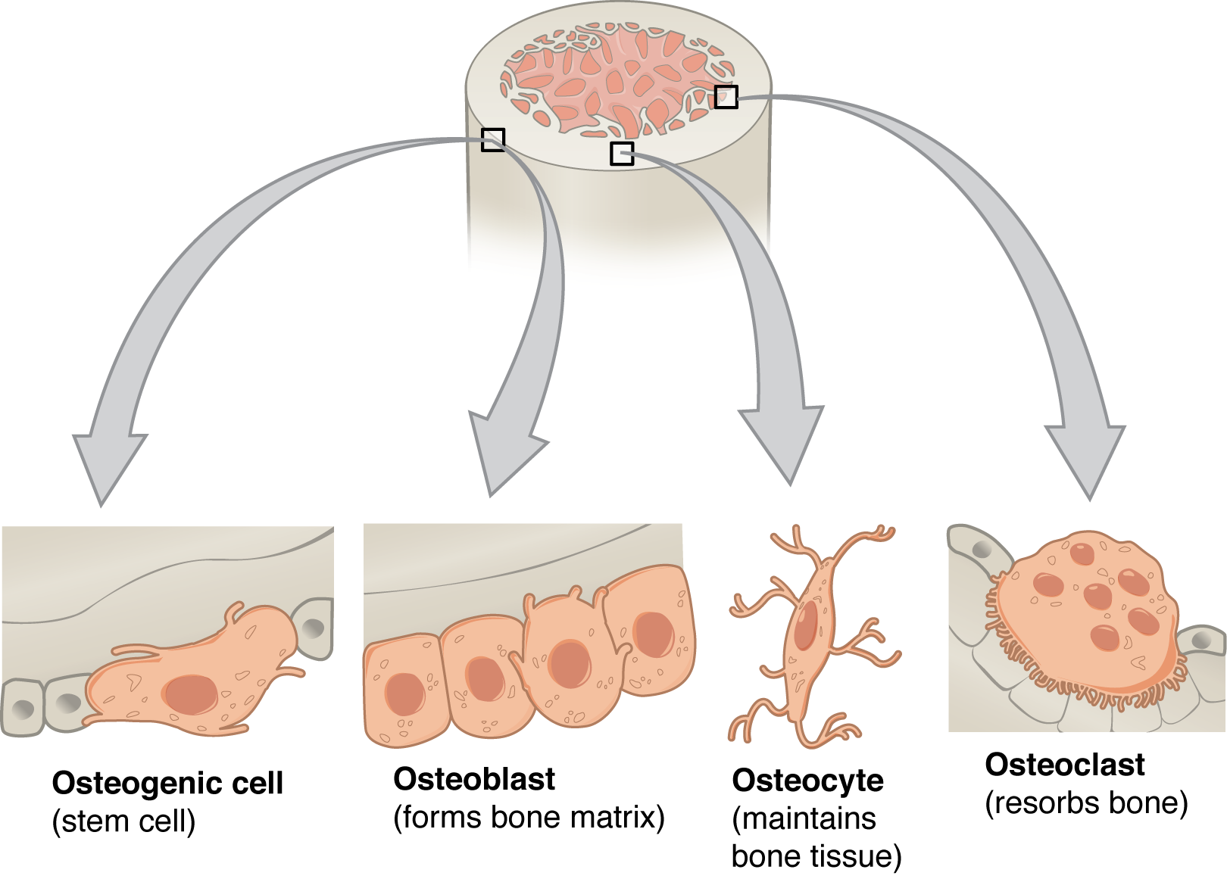
https://open.oregonstate.education/aandp/chapter/6-3-bone-structure/

Slide 33
Bone Growth
Growing skeleton
Longitudinal growth until epiphyses close from pubertal hormone exposure
Continue to increase bone mass and accumulate calcium until age 30
Peak bone mass age 30
Grown skeleton
Slow bone loss after 30 (both matrix and mineral)
Accelerated loss after menopause for approx. 10 years
Accelerated loss with some illnesses and medications

Slide 34
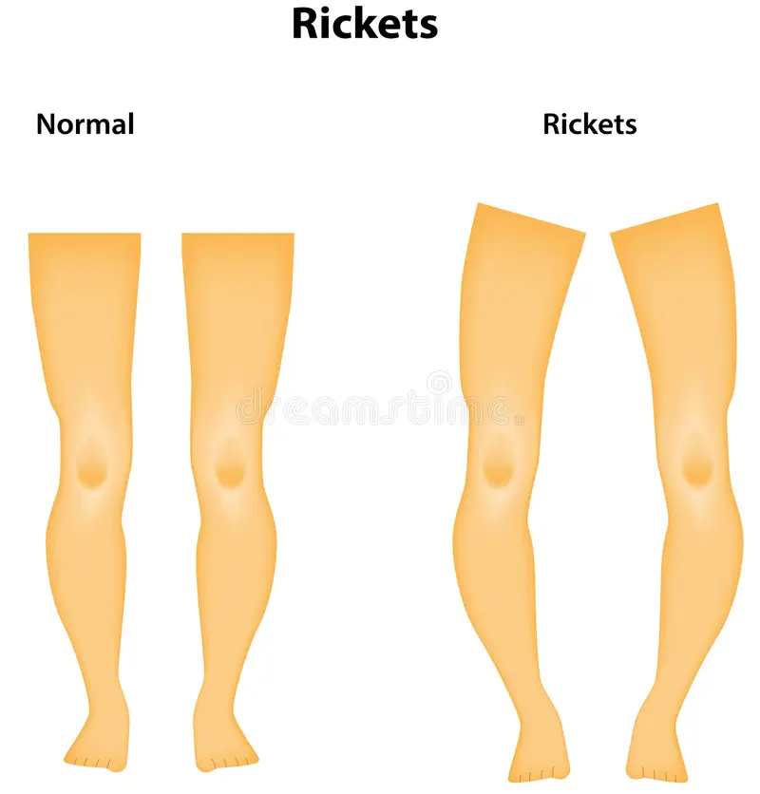
Osteoporosis vs osteomalacia vs rickets
Osteoporosis is reduced matrix and reduced mineral (matched) ie less bone
Osteomalacia is reduced mineral but not reduced matrix ie unmineralised bone
Rickets is unmineralised bone in growing bone (child)
Usually bowing of weightbearing limbs

Slide 35
Hormonal, nutritional effects on bone

Slide 36
Estrogen
https://www.corkmenopauseclinic.com/osteoporosis/

Slide 37
Other influences
Hormonal
Anabolic
Testosterone
Growth hormone
Catabolic (in excess)
Thyroid hormone
Glucocorticoids (cortisol, pharmaceutical)
Nutritional
Eating disorders
Malnutrition
Malabsorption
Biomechanical
Body weight
Impact exercise
Weightlessness - 1% to 2% per month involving the lower extremities and spine

Slide 38
Case history - continued
32yr male
Stress fracture femur
Osteoporosis

Slide 39
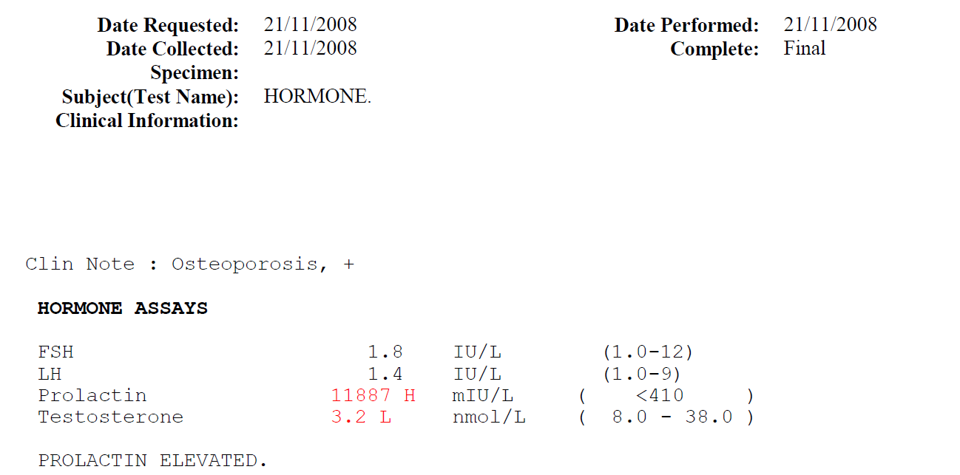
Investigations

Slide 40
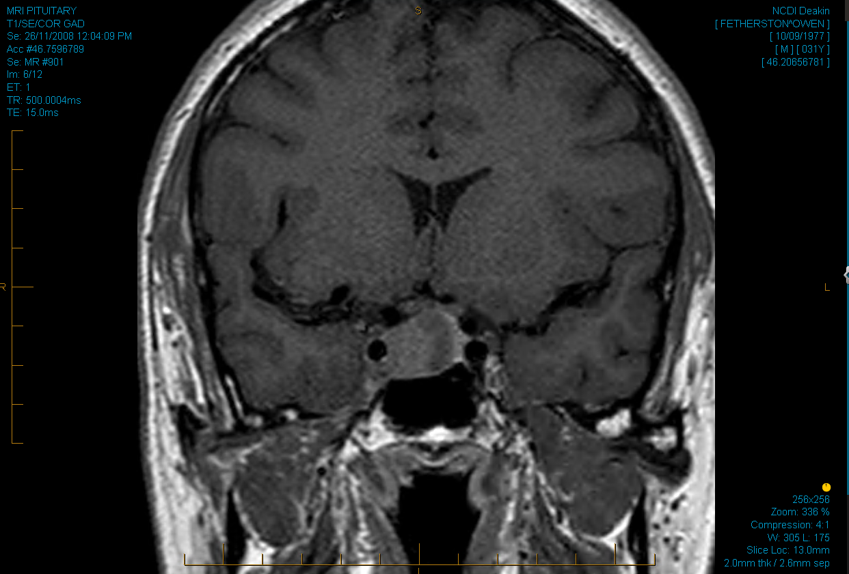

Slide 41
Progress
Treated with Cabergoline (dopamine agonist) and testosterone injections
Progressive lower leg weakness
Leg ulcers
May 2013
Diagnosed with Charcot-Marie-Tooth syndrome (hereditary motor sensory neuropathy)

Slide 42
Diagnosis – osteoporosis with stress fracture
Contributing factors:
Androgen deficiency (pituitary tumour)
Probable biomechanical factors

Slide 43
Summary
Case history
Calcium
Bone metabolism & cells
Regulation of calcium & bone
Vitamin D
Parathyroid hormone
Estrogen/testosterone
Other factors – nutrition, mechanical

