Slide 1
Diabetes in the Elderly
Robert Schmidli
MBChB, FRACP, MRCP, PhD
Clinical Senior Lecturer, ANU Medical School
Senior Staff Specialist, TCH

Slide 2
Outline
Case study
Evidence base
Control and complications
Aims of treatment
Pharmacological agents
Use of insulin

Slide 3
Case presentation

Slide 4
74 year old lady
Diagnosed type 2 diabetes 2003
Seen by colleague initially
Seen by me Aug 2009
Glimepiride (Amaryl) 4mg daily
Glargine (Lantus) 58-60 units nocte
Metformin 1g BD
Previous treatment with Exenatide (Byetta), Sitagliptin (Januvia) led to worsening of control

Slide 5
Examination, pathology
BMI 36.4
BP 154/96 (home systolics ~120)
No neuropathy
HbA1C 9.8%
Normal renal function, no microalbuminuria

Slide 6
Progress
HbA1C high 8s, low 9s
July 2011
Lantus changed to BD Novomix 30, stopped Glimepiride
Thyroxine for subclinical hypothyroidism (TSH 4-5) – previous wt loss
October 2011
BGLs < 10
HbA1C 8.4%
2kg weight gain
December 2014
HbA1C 8 – 9%
Started on Dapagliflozin (Forxiga) 10mg daily

Slide 7
Progress (contd.)
March 2015
Polyuria, vaginal candidiasis – controlled with Canesten
Reduced insulin requirements
HbA1C 9.3 → 8.2%
August 2015
Diagnosed Parkinson’s disease
HbA1C 9.1%
August 2018
Requested Exenatide (Byetta) for Parkinson’s disease (“off label”)

Slide 8
Progress (contd)
2021
Trial cessation Dapagliflozin
Increased HbA1C
Started on Empagliflozin (Jardiance)
Exenatide replaced with Dulaglutide (Trulicity)
HbA1C 8.0%

Slide 9
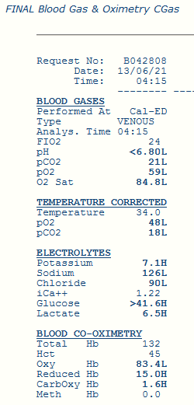
June 2021
Diarrhoea & vomiting
Stopped insulin temporarily
Admitted to ICU Calvary
Undetectably low pH on admission
Unrecordably high BGL
Recovered with IV dextrose & insulin

Slide 10
Further investigations
Diagnosis: unrecognised type 1 diabetes

Slide 11
Progress
Empagliflozin, Metformin, Dulaglutide stopped
Basal bolus insulin
Little change in control
November 2022
Further admission with DKA – BGL 50.5, pH 7.21
Possibly related to insulin admission
Declining cognitive state
Attempted Freestyle Libre – not successful
March 2023
Contacted by son
Further cognitive decline. Will require visits by carer to supervise insulin
Changed to BD premix insulin

Slide 12
Control and complications

Slide 13
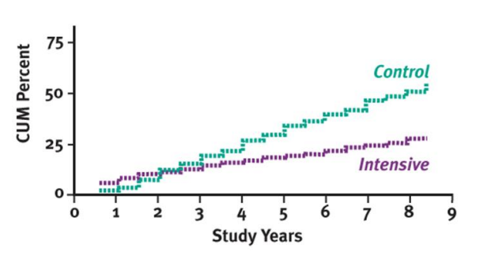
Type 1 diabetes
Diabetes Control and Complications Trial (DCCT)
Completed 1993
Average 6.5y treatment
HbA1C 7 vs 9 (intensive vs conventional)
Improvement in microvascular but no
no difference in macrovascular complications
Epidemiology of Diabetes Interventions and Complications
Patients monitored for up to 30 years
No difference in control during post-DCCT years
Reduction in CVD (30%), & major CV events (32%)

Slide 14
UK Prospective Diabetes Study
First study of control and complications in type 2 diabetes
Uncertainties
Possible increased CV mortality with sulphonylureas
Insulin may be atherogenic
Intensive vs conventional control
3867 newly diagnosed patients, median age 54y
Collected 1977 – 1997. Initial analysis in 1997
Intensive group
Sulphonylurea + insulin – FBG < 6mmol/L
Metformin in obese patients
Conventional group – treat if symptomatic, FBG >15

Slide 15
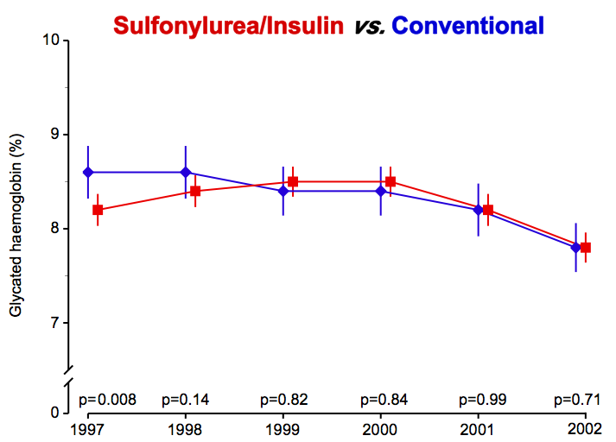
Post-Trial Changes in HbA_{1c}
UKPDS results presented
Mean (95%CI)

Slide 16
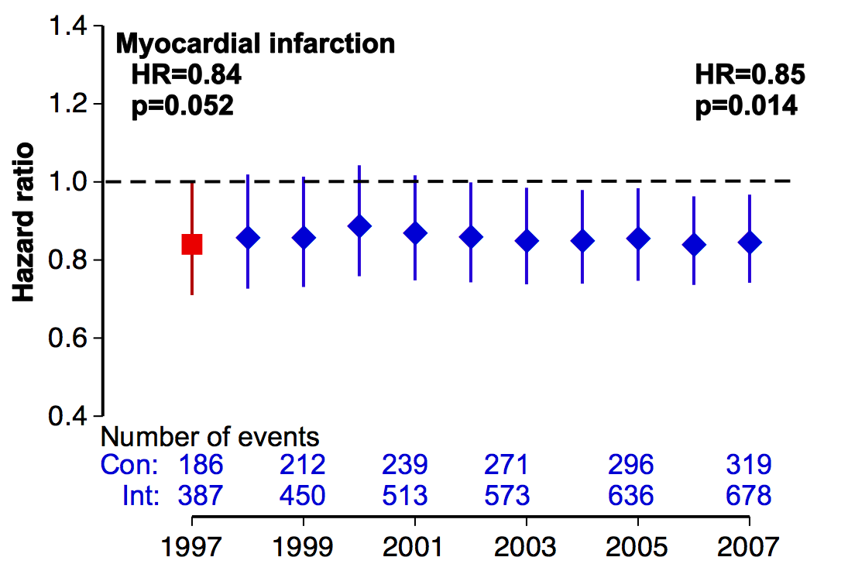
Myocardial Infarction Hazard Ratio
(fatal or non-fatal myocardial infarction or sudden death)
Intensive (SU/Ins) vs. Conventional glucose control
HR (95%CI)

Slide 17
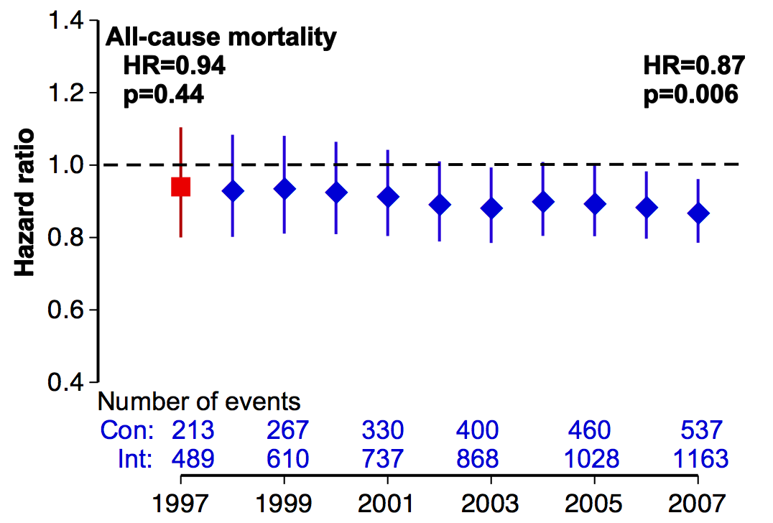
All-cause Mortality Hazard Ratio
Intensive (SU/Ins) vs. Conventional glucose control
HR (95%CI)

Slide 18
ACCORD study
Aimed to examine effect of lowering blood glucose into “normal” range
~10,000 patients
Age 55 – 79y
HbA1C target < 6.0 vs “standard” (7.0)
Medications: Metformin, Glimepiride, Repaglinide, Rosiglitazone, Acarbose, Exenatide, Insulin (any)
Final outcome 6.4 vs 7.5%
Primary outcome:
First occurrence of nonfatal myocardial infarction or nonfatal stroke or death from cardiovascular causes

Slide 19
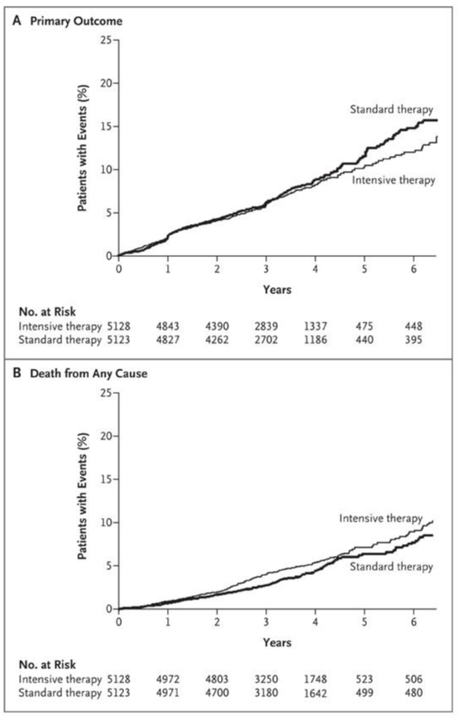
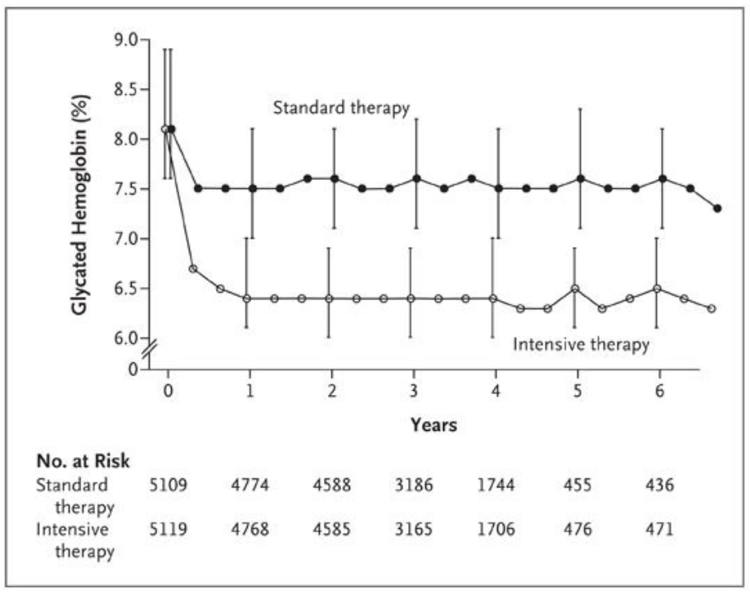
Results
Glycated Hb at study visits
257 vs 203 deaths in intensive/standard group
Study terminated because of excess deaths in study group
Cardiovascular safety trials mandated for hypoglycaemic drugs

Slide 20
Specific agents: SGLT-2 inhibitors
EMPA-REG trial – N Engl J Med 2015; 373: 2117
7020 at-risk patients, 3.1yr, empagliflozin or placebo
Composite CV outcome 10.5% vs 12.1% (p=0.04)
Lower CV death, all-cause mortality, hospitalisation for heart failure
Dapagliflozin – N Engl J Med 2019; 380: 347
N = 17,160 – 10,186 had no atherosclerotic disease
Nonsignificant reduction in MACE
Reduction in hospitalisation for heart failure
Lower risk group than EMPA-REG

Slide 21
Specific agents: GLP-1 agonists
Liraglutide (LEADER) - N Engl J Med 2016; 375:311
GLP-1 agonist
9340 patients, 3.8yr
Reduction in CV and all-cause death
Dulaglutide (REWIND) – Lancet 2019; 10193: 121
Reduction in MACE
Semaglutide (SUSTAIN-6)
Reduction in CV death, non-fatal MI, non-fatal stroke

Slide 22
Aims of treatment

Slide 23
General considerations
Highly heterogeneous group – wide variation in physical & cognitive function
Ageing associated with changes in insulin sensitivity, adipose & muscle function, β cell function, polypharmacy, skills & competence
Lack of good evidence base: most studies of complications observational or retrospective
Most RCTs only compare two HbA1C levels. Do not give targets!

Slide 24
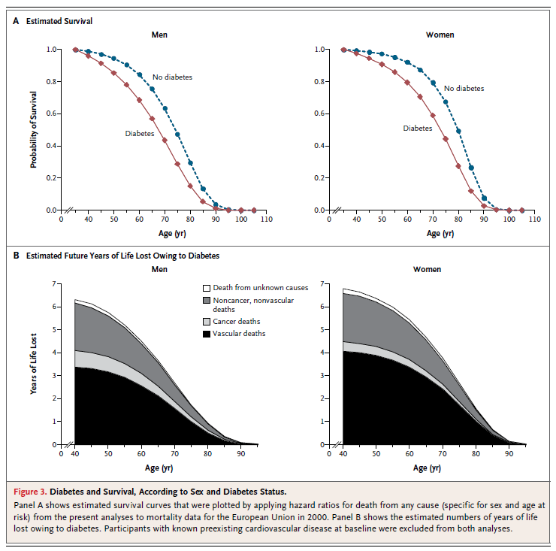
Diabetes and mortality
N Engl J Med 2011;364:829-41.
N Engl J Med 2011;364:829-41.

Slide 25
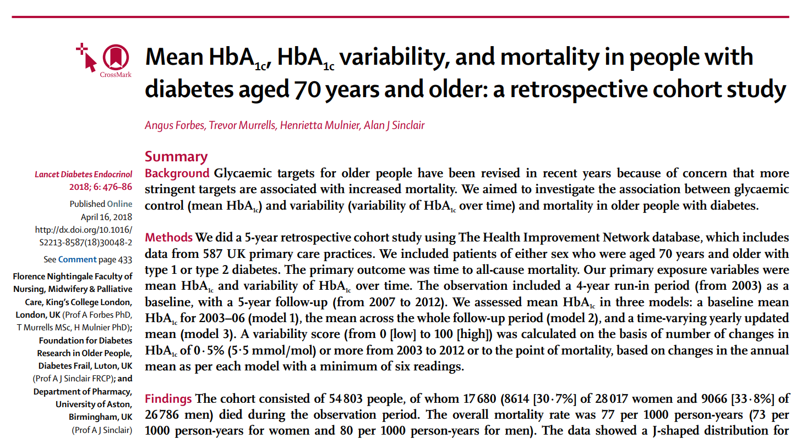

Slide 26
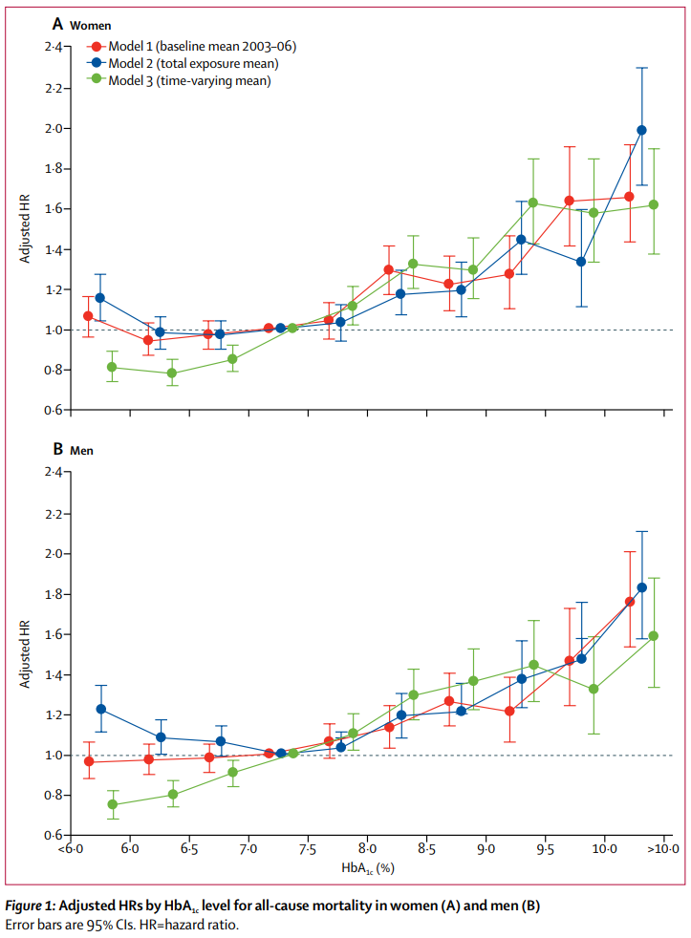
HbA1C & mortality
Data from 587 UK primary care practices
Age ≥ 70y
Type 1 & 2 diabetes
4-year run-in, 5y follow-up
Measured HbA1C & HbA1C variability
N = 54,803
Outcome – time to all-cause mortality
Results suggest stable glycaemic levels in middle range associated with lowest risk
Forbes A et al Lancet Diab Endocrinol 2018; 6: 476 - 86

Slide 28
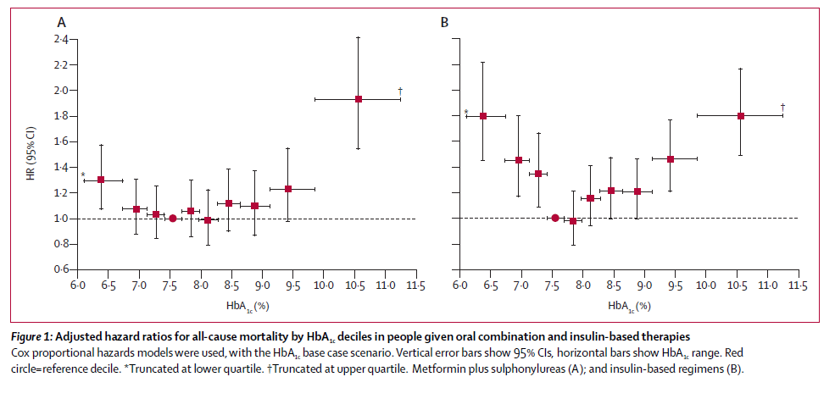
Group A (oral agents): 27,965, group B (insulin): 20,005
Age ≥ 50y, mean 64, period 1986 – 2008
Hazard ratio insulin-treated vs oral 1.49
Currie C et al Lancet 2010; 375: 481-9

Slide 29
General themes
No benefits of tight control of HbA1C below 7.0 – 7.5
“J” shaped curve between HbA1C and complications, including mortality
Optimal HbA1C 7.5 – 8.0%
High comorbidity burden reduces benefits of improved glycaemia
Greater risk with HbA1C <6.0 and > 9.0%
Variability in HbA1C may be important
Management of hypertension essential
No trials of statin treatment in older people

Slide 30
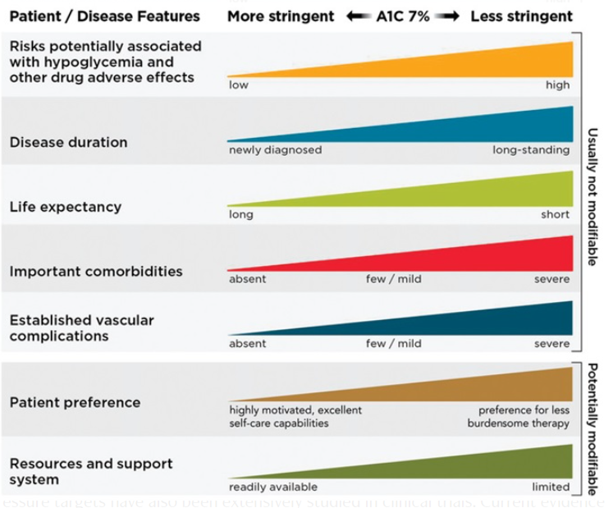
Individualisation of treatment

Slide 31
Pharmacological agents

Slide 32
Metformin
First-line treatment in all guidelines
GI side effects common
Less common with XR preparation (after evening meal)
Lactic acidosis rare
May be related to dehydrating illness rather than renal function
Renal impairment:
eGFR 30-40: maximum dose 1000mg/day
eGFR < 30: stop

Slide 33
Sulphonylureas (Gliclazide, Glimepiride, Glibenclamide)
Cheap, can be highly effective
Effective at all blood glucose levels → hypoglycaemia
Lack of durability
Weight gain
Good alternative to insulin in elderly
No longer second-line (except PBS)

Slide 34
DPP4 inhibitors (Sitagliptin, Linagliptin, Saxagliptin, Vildagliptin, Alogliptin)
Increases GLP-1 levels by inhibiting breakdown enzyme
Very well tolerated
Efficacy lower than other agents
No CV or other benefit on complications

Slide 35
GLP-1 agonists (Semaglutide, Dulaglutide, Liraglutide, Exenatide)
Long-acting GLP-1 analogues
Inhibit appetite through delayed gastric emptying & central effect
Lower BGL through insulinotropic & anti-glucagon effect
Good efficacy, weight loss
GI side effects – nausea, diarrhoea, constipation
Up-titration (all except Dulaglutide)
Semaglutide most efficacious
Renal impairment – Dulaglutide eGFR >15
CV benefits (all except Exenatide)
Exenatide no longer available, Liraglutide not PBS

Slide 36
SGLT-2 inhibitors (Empagliflozin, Dapagliflozin)
Glycosuric effect
Less BGL lowering than GLP-1a
Weight loss
Cardiac, renal benefit
Modest decline in kidney function, long-term protection
Avoid if eGFR < 30 & diabetic
Vaginal candidiasis, balanitis. ?Increased risk UTI
Risk of ketoacidosis with fasting, very low calorie or ketotic diet
Caution in elderly. Consider C-peptide ± antibodies first
GAD, IA-2, ZnT8
Other conditions:
Dapagliflozin: symptomatic heart failure*, chr kidney disease*
Empagliflozin: secondary prevention CVD (diabetes), heart failure*
PBS – in non-diabetic patient

Slide 37
Insulin
No side effects except hypoglycaemia & weight gain
Useful in patients with complex medical problems
Consider other options first
No proven CV benefit beyond glycaemic control
Logistically difficult in elderly patients – loss of independence
Consider likely benefits carefully
Simple → complex regimens
Avoid basal bolus in elderly type 2 patients

Slide 38
Insulin
Nondiabetic
BD Mixed
Basal bolus
Meals

Slide 39
Drug combinations
Don’t combine DPP4 inhibitor with GLP-1 agonist (both act on GLP-1)
Consider stopping sulphonylurea if on insulin
Combinations more effective than single agents
PBS rules – not permitted:
SGLT-2i + GLP-1 agonist (can use 12.5mg Empagliflozin on private script)
Must be on Metformin + Sulphonylurea before starting SGLT-2i, GLP-1ra, DPP-4 inhibitor unless contra-indication (e.g. weight gain, hypoglycaemia)
Monotherapy: SGLT-2i, GLP-1ra, DPP-4

Slide 40
Other agents – limited usefulness
Pioglitazone
Insulin sensitiser
Durable effect
Some CV benefit
Weight gain, fractures, cardiac failure
Can consider in extreme insulin resistance, NAFLD/NASH
Acarbose
Weight neutral
Relatively weak hypoglycaemic effect
Flatulence, GI side effects

Slide 41
Inpatient management

Slide 42
Inpatient issues
Frequently undiagnosed
Stress induced
May resolve with acute condition
Check HbA1C
Aggravation in hospital
Acute illness
Inactivity
Hospital meals
Disruption of routines
Difficult to optimise management as inpatient
Don’t admit just to stabilise blood glucose

Slide 43
Common errors
Withholding of insulin because of low BGL (type 1)
Over-treatment of hyper and hypoglycaemia
Use of sliding scale up until discharge
Avoidance of long-acting insulin
Failure to plan for discharge
Failure to listen to the patient
Inappropriate treatment targets

Slide 44
Conclusions
Highly diverse patient group – optimal treatment requires full knowledge of patient’s medical, social, cognitive status
No ideal hypoglycaemic agent
Drug combinations more effective than monotherapy – when appropriate
Optimal HbA1C depends on life expectancy, co-morbidities, expected outcomes, social setting and cognitive ability
Generally HbA1C 6.5 – 8.5% optimal
Hypoglycaemia may increase mortality

