Slide 1
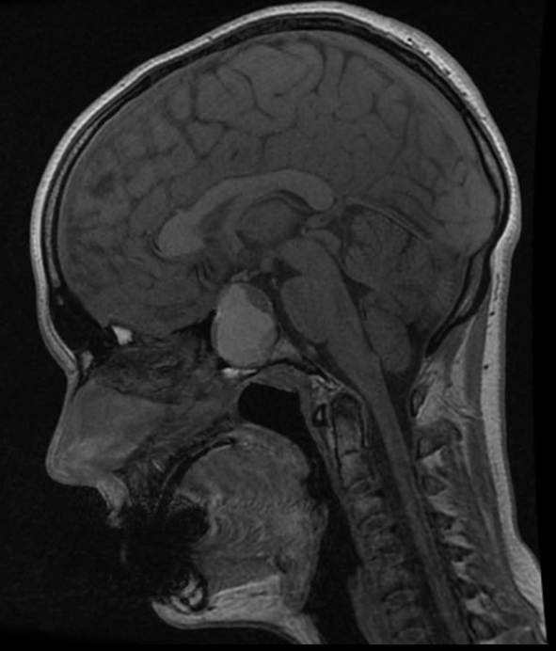
MRI 24/10/16
Prl 38,000

Slide 2
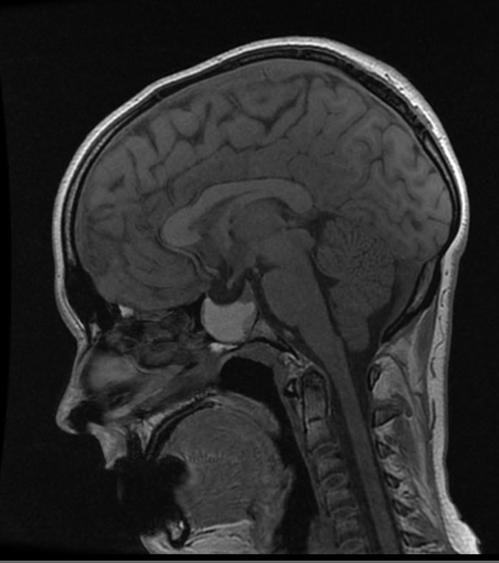
15/12/16
Cabergoline
0.5mg twice a week
Prl 7440
July 2017
Cabergoline x4/week
Testo 7.5nmol/L
Started on Andriol
Testogel 1 sachet/day
Sept 2017
Prl 2890

Slide 3
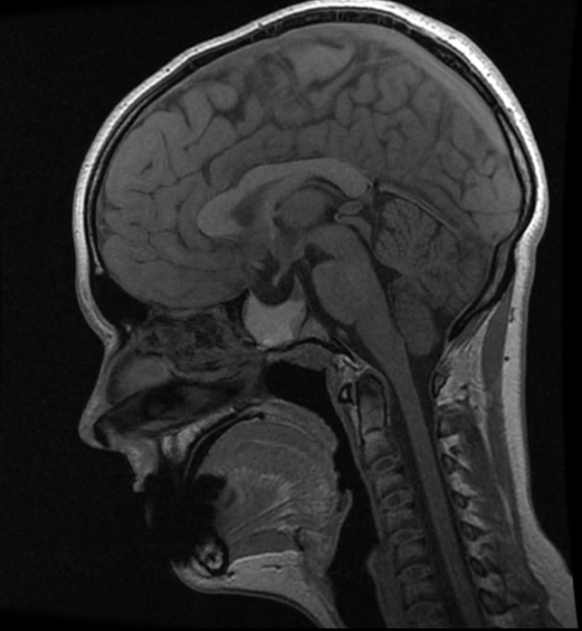
10/4/17
3 Cabergoline/wk
Prl 6630

Slide 4
Progress
Referred to S Robson for semen collection
Gonadotrophic therapy
Pregnyl, Gonal-F

Slide 5
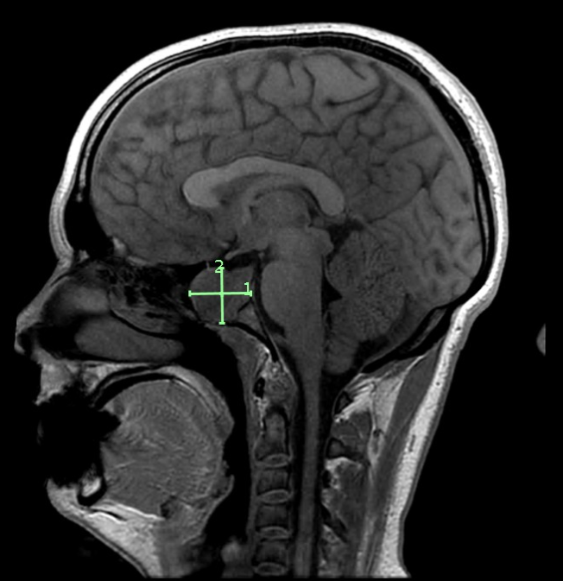
July 2018
Prolactin 29,000mIU/L
Discussed at CME meeting
Increase Cabergoline to 3mg/week

Slide 6
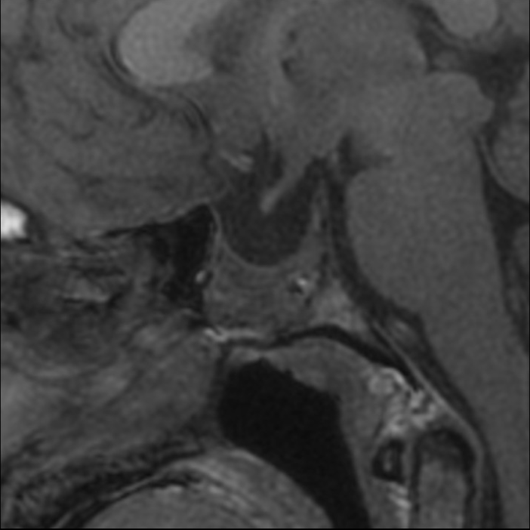
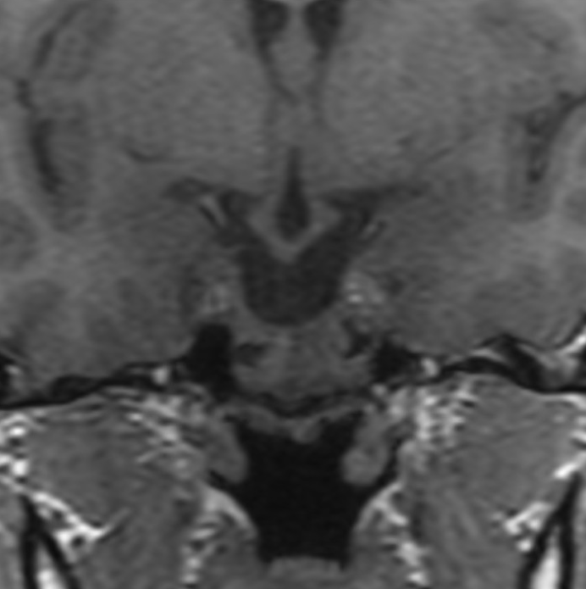
July 2022

Slide 7
Current status
6 Cabergoline 0.5mg/week
No side effects
Testogel 4 pumps/day
Prolactin 7300 mIU/L
Testosterone 20nmol/L
IGF-1 13 nmol/l
Max GH response to Glucagon 2.0mcg/L
Declined GH therapy

Slide 8
Plan
Annual MRI
6-monthly prolactin
Annual MRI
2-yearly echocardiogram

