Slide 1
Role of the pituitary in the endocrine system
Robert Schmidli
MB ChB, MRCP, FRACP, PhD
Consultant endocrinologist
Clinical Senior Lectureer, ANU Medical School
http://www.schmidli.com.au
endo@schmidli.com.au

Slide 2
Lecture outline
Case history
Structure and function
Pituitary and hypothalamic hormones
Disorders of pituitary function
Discussion – case history

Slide 3
Case history

Slide 4
Mrs “R”: 64-year-old lady
Attended diabetes clinic for routine review
Incidental ↑ blood glucose 2y previously
Daughter has type 1 diabetes
On oral hypoglycaemic agents
Diabetes well controlled
Hypertension

Slide 5
Assessment
Unusual facial appearance, deep nasal voice
Denied any other problems
Sinus problems
Enlarged nose
Thickened skin
Deep voice
Increased soft tissue in hands and feet
Visual fields normal

Slide 6
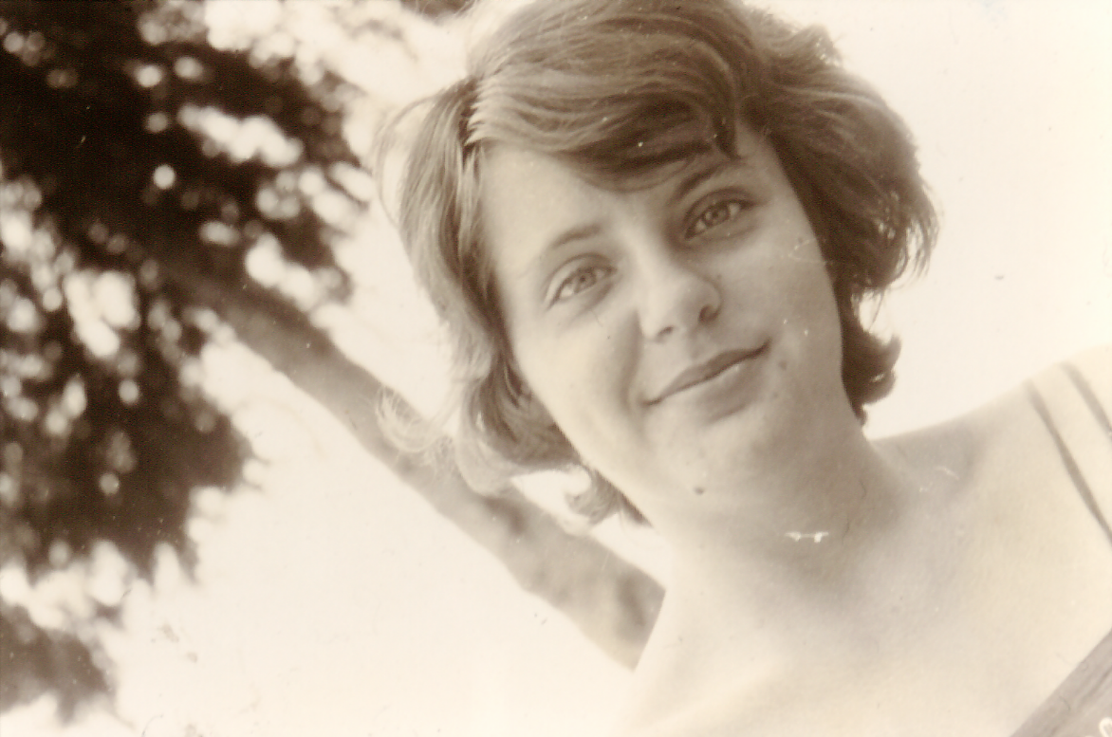
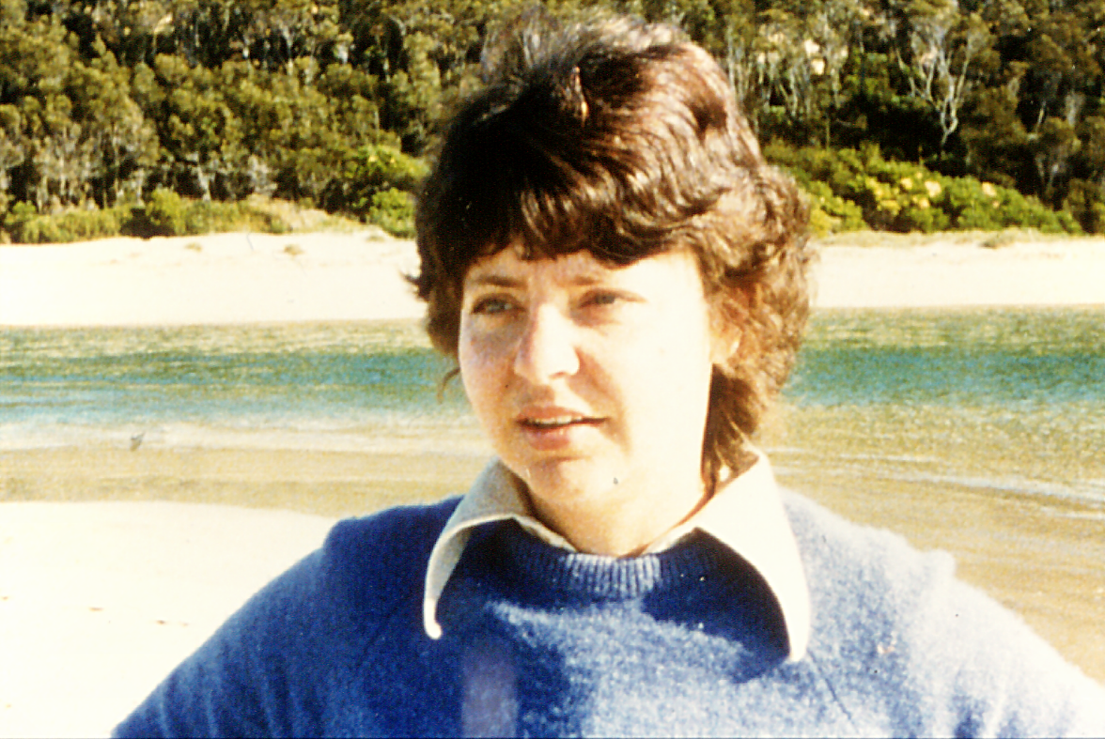
Mrs “R”
20 years
39 years

Slide 7
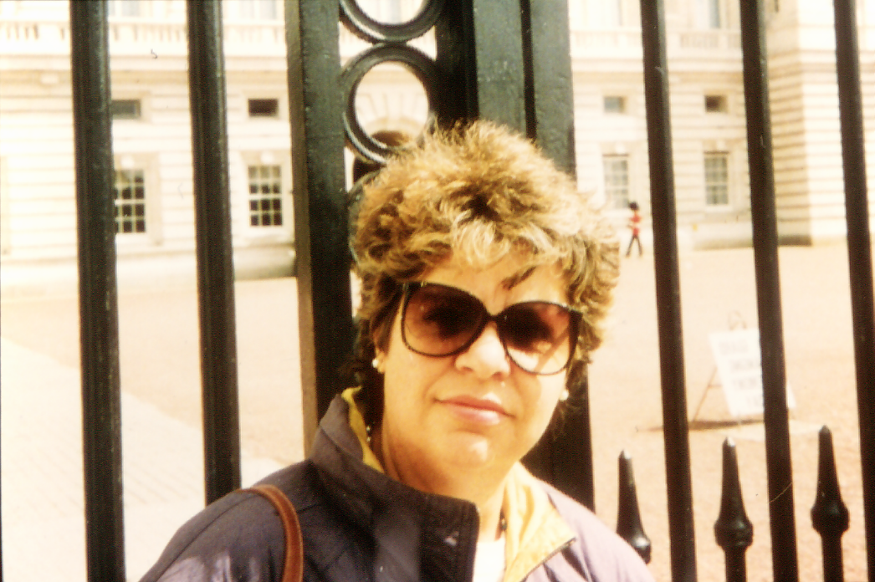
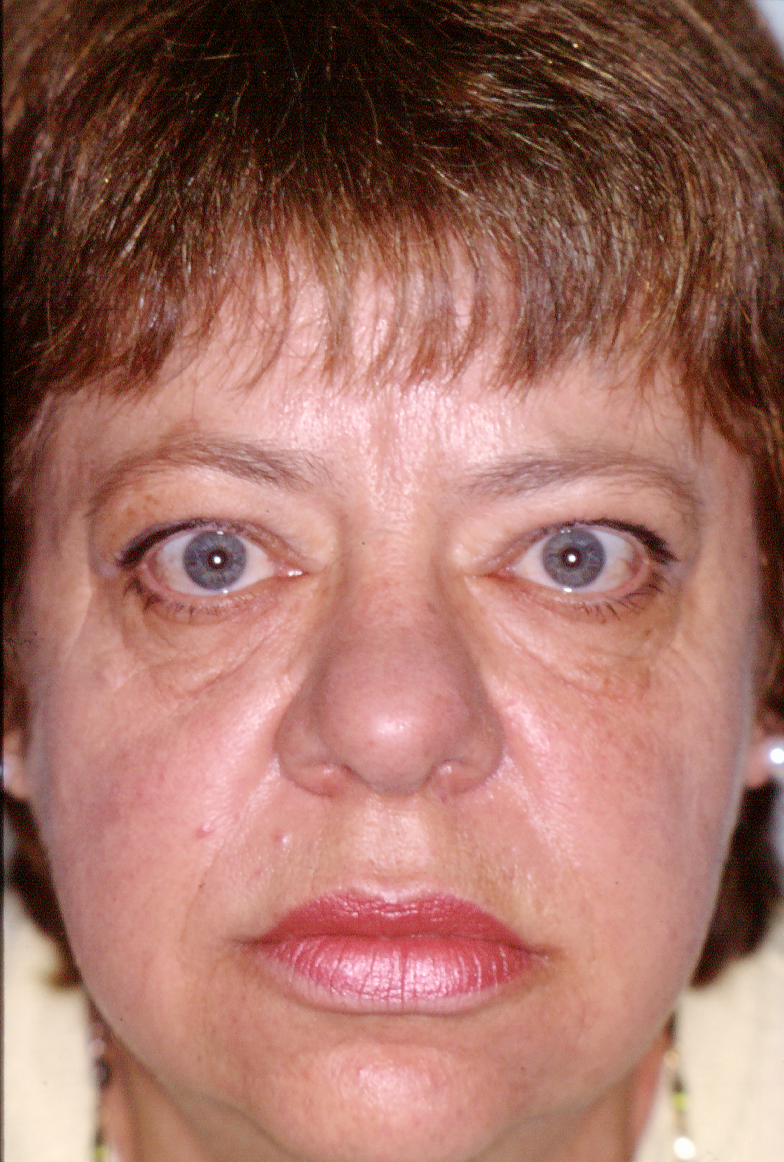
53 years
Current

Slide 8
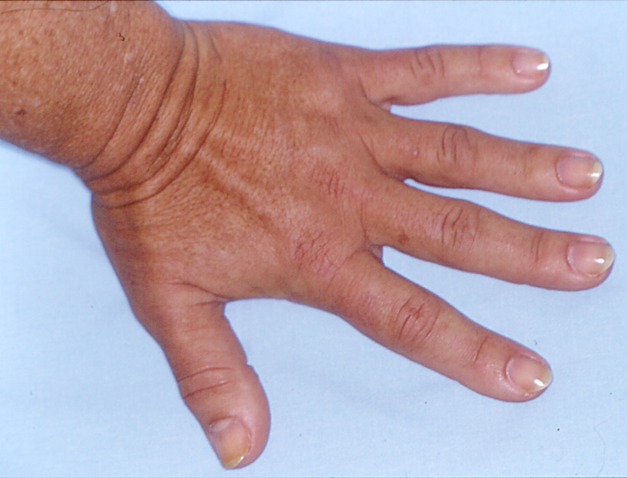
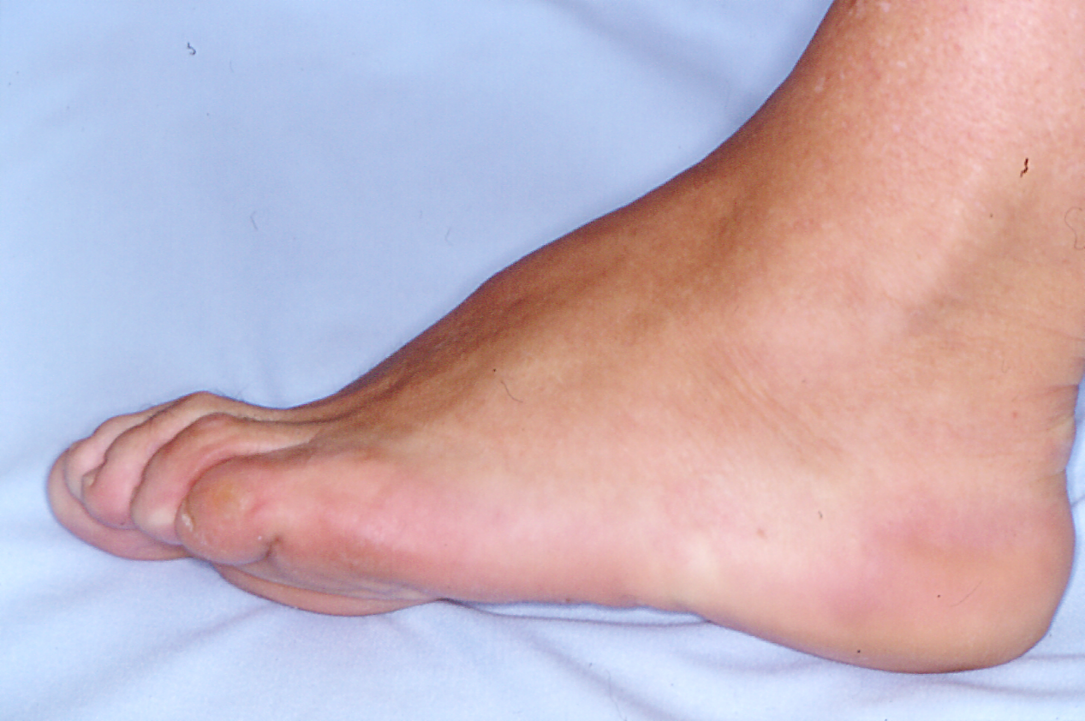

Slide 9
Investigations
Growth hormone:
  59.3 mU/l [<25]
Insulin-like growth factor-1 (IGF-1):
  862 μg/l [98-390]
Skull X-ray:
  erosion of dorsum sellae
Hand X-ray:
  prominent tufts of the terminal phalanges

Slide 10
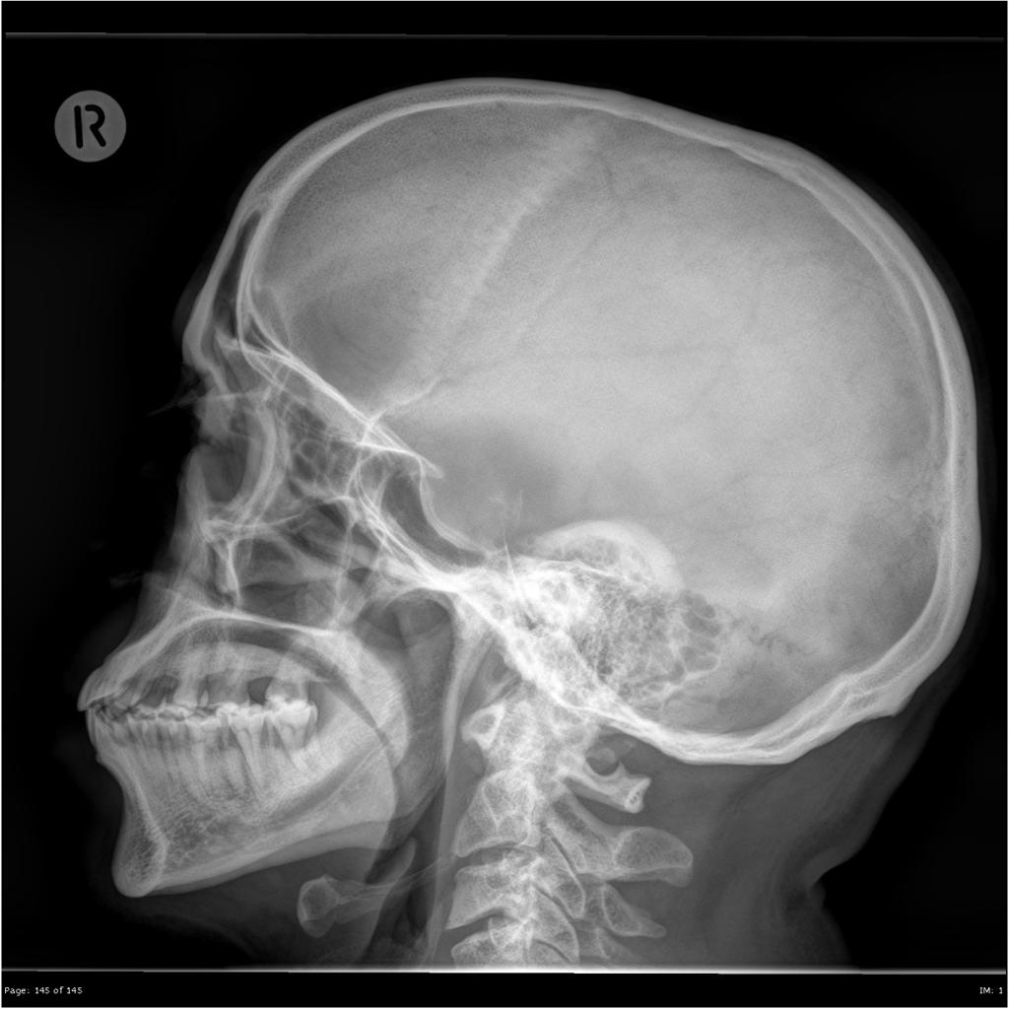
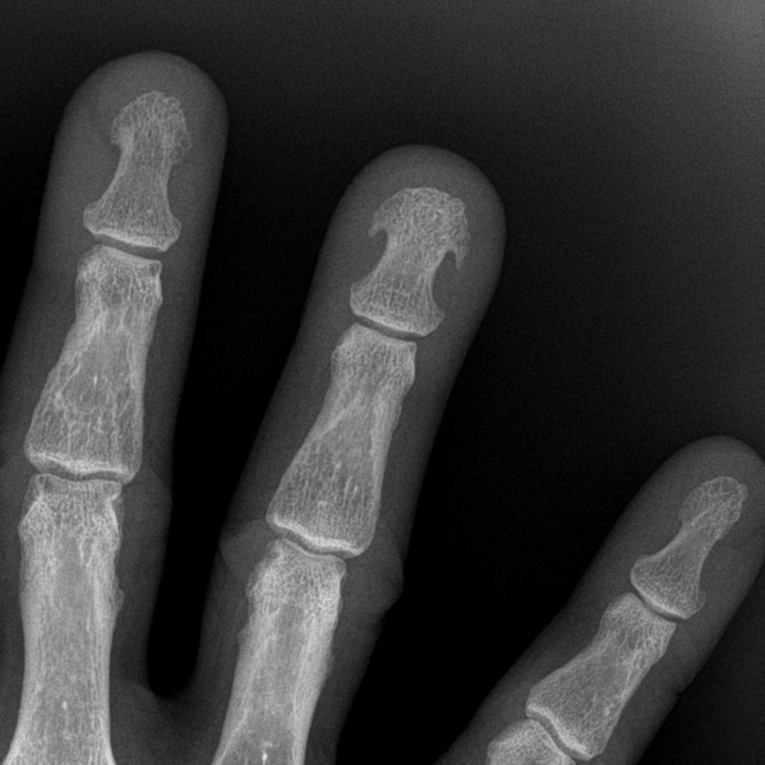

Slide 11
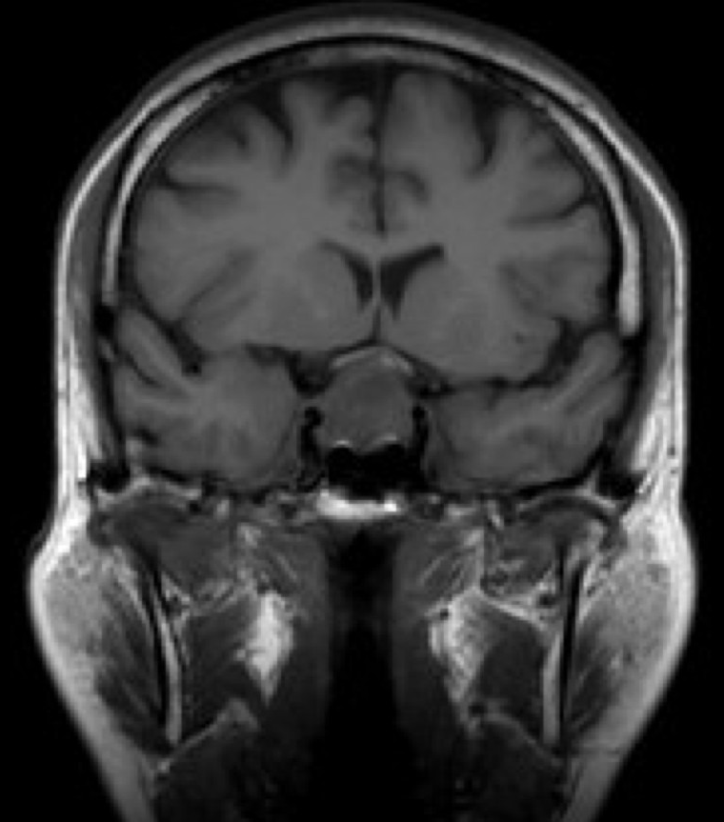
Magnetic resonance scan pituitary
Optic chiasm
Tumour

Slide 12
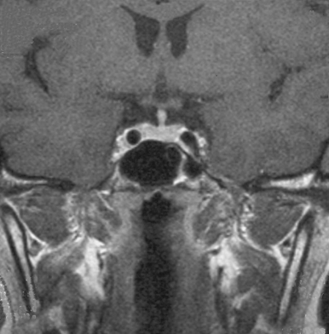
Normal pituitary
Magnetic resonance scan
Lateral ventricle
Pituitary stalk
Optic chiasm
Pituitary
Internal carotid
Sphenoid sinus

Slide 13
Progress
Trans-sphenoidal surgery
Sweating improved
Face became less puffy
Hypertensive: 184/104 – later improved
GH 2.1
IGF-1 302
Able to stop oral hypoglycaemics
Currently remains free of symptoms

Slide 14
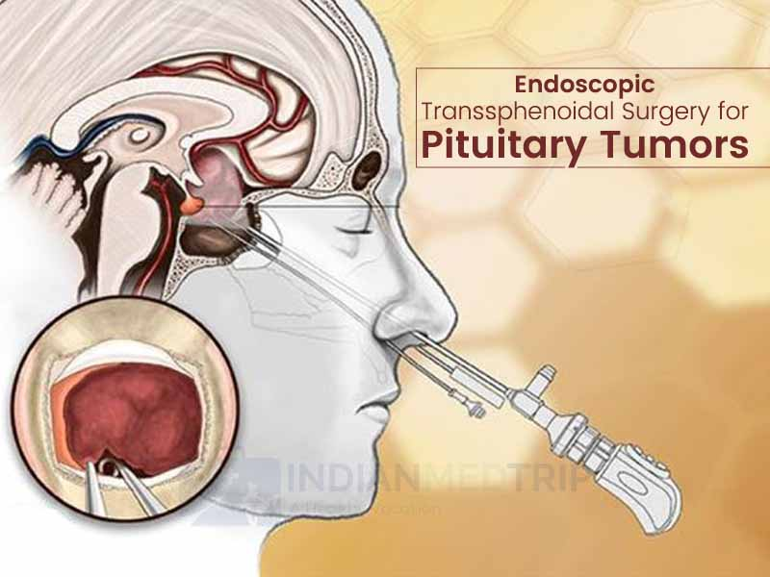

Slide 15
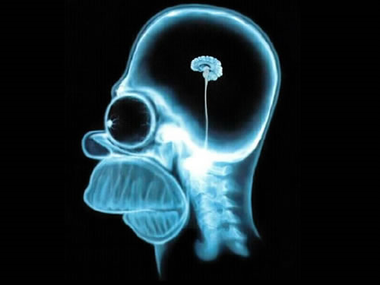
Structure and function

Slide 16
The hypothalamus and pituitary
Autonomic function
Higher centres
Endocrine feedback
Environmental cues
HYPOTHALAMUS
PITUITARY
ENDOCRINE GLANDS

Slide 17
The hypothalamus
Interface between brain and endocrine system; coordinating centre
Base of brain, below thalamus
Size of almond in humans
Regulation of pituitary
Temperature regulation, appetite
Appetite, autonomic nervous system
Unique blood supply

Slide 18
The Pituitary Gland
Small outgrowth of the forebrain
Located below hypothalamus
Two functional parts
  Adenohypophysis (anterior pituitary)
    Rathke’s pouch – ectoderm above mouth
  Neurohypophysis (posterior pituitary)
    Hypothalamus
Move together during development

Slide 19
Anatomy
Hypothalamus → pituitary stalk → pituitary
Stalk passes through opening in dura
Gland lies outside the dura
Relations:
  Optic nerve above
  Sella turcica below
Almost directly behind the area between the eyes
Can be accessed surgically through the back of the nose (the sphenoid bone)
Distinctly visible structure on magnetic resonance imaging (MRI) scanning

Slide 20
Blood and nerve supply
Hypothalamus
  Hypothalamic neurons release hormones directly into capillary plexus
Anterior pituitary
  Blood supply from median eminence of hypothalamus – portal system
  Hormones from hypothalamus to pituitary
  Sympathetic/parasympathetic nerves
Posterior pituitary
  Supraoptic and paraventricular nuclei in hypothalamus

Slide 21
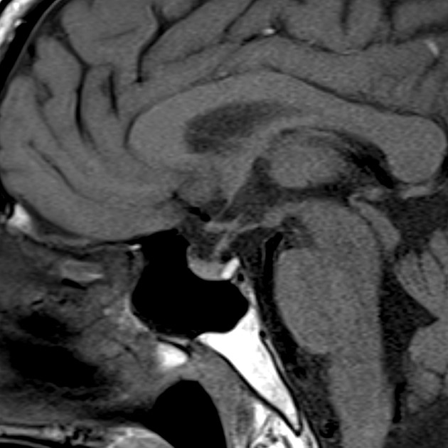
Pituitary stalk
Hypothalamus
Posterior
pituitary
“bright spot
Anterior
pituitary

Slide 22
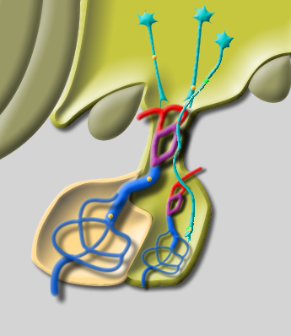
Structure of pituitary
Hypothalamic releasing hormones
Pituitary stalk
Portal vessels
Anterior pituitary
Posterior pituitary

Slide 23
Function of anterior pituitary gland
Removal results in atrophy and hormone deficiency of:
  Thyroid
  Adrenal cortex
  Gonads
  Growth hormone
Death due to cortisol deficiency

Slide 24
Feedback loops
Hypothalamus
Releasing
hormone
Short
feedback loop
Pituitary
Long
feedback loop
Trophic
hormone
Peripheral
gland
Active
hormone
ACTION

Slide 25
Pituitary and hypothalamic releasing hormones

Slide 26
Posterior pituitary hormones
Vasopressin/Antidiuretic hormone (ADH)
  Produced by supraoptic nucleus
  Conserves water - concentrates urine
  Water reabsorption by distal collecting tubule & collecting duct via V receptors & cAMP
  Activates Aquaporin 2 channels – allows passive movement of water into cells with Na & urea
  Results in concentrated urine in dehydration
Oytocin
  Milk let-down

Slide 27
Anterior pituitary hormones
TSH: Thyroid stimulating hormone
ACTH: Adrenocorticotrophic hormone
LH: Luteinising hormone
FSH: Follicle stimulating hormone
Prolactin Dopamine (negative)
GH: Growth hormone

Slide 28
Thyrotrophin (TSH)
Stimulates: thyroxine synthesis
thyroid growth
Regulation:
  TRH: stimulates release
  Inhibited by thyroid hormones (T3, T4) – feedback inhibition
Acts via cAMP

Slide 29
Control of thyroxine synthesis
↓ T4
↑ TSH
Insult:
Immune
Radiation
etc
↓ T4 synthesis

Slide 30
Corticotrophin (ACTH)
Released as prohormone: pro-opio-melanocortin
Maintenance of adrenal cortical function
  Cortisol
  Other adrenocortical hormones (eg androgens)
  Pigmentation in excess (Addison’s disease)
Control of ACTH secretion:
  CRH, Vasopressin
  Cortisol (feedback inhibition)

Slide 31
Luteinising hormone: LH
Males:
  Leydig/interstitial cells – testosterone
  Inhibited by testosterone
Females:
  Interstitial cells – estrogen, androgens, progestins
  Inhibited by estrogen

Slide 32
Follicle stimulating hormone: FSH
Regulation of gametogenesis
Males:
  Sertoli cells – development of spermatozoa
  Inhibited by inhibin
Females:
  Granulosa cell of ovarian follicle
Works synergistically with LH

Slide 33
Prolactin
Secreted by lactotrophs of ant. pituitary
Lactation: only known function
Inhibits reproductive hormone secretion
Release inhibited by dopamine “prolactin inhibitory factor”
Animals: osmoregulation, growth
Stalk transection → ↑ prolactin

Slide 34
Growth hormone
Promotes growth: skeleton, muscles, viscera
Effects mediated by somatomedins – IGF-1
Released at night during growth
Variety of metabolic effects
  Anabolic, positive nitrogen balance
  Anti-insulin
Stimulated by GHRH, stress, exercise
Inhibited by somatostatin
  Secreted in GI system and CNS
  Regulatory hormone – largely paracrine

Slide 35
Pituitary releasing hormones
Small peptides
Active at relative high concentrations
Rapidly degraded
Rapidly diluted in peripheral circulation
Special circulation allows high concentrations to reach targets for short duration
Crucial for releasing hormones with pulsatile release (e.g. GnRH)

Slide 36
Pituitary releasing hormones
CRH: Corticotrophin releasing hormone (ACTH)
TRH: Thyrotrophin releasing hormone
GHRH: GH releasing hormone
Somatostatin: GH inhibition
Vasopressin: ACTH secretion

Slide 37
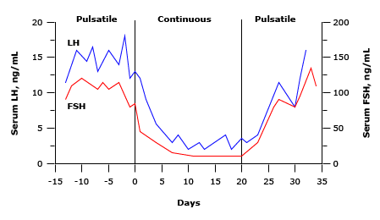
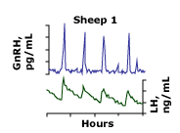
GnRH - Gonadotrophin (LH, FSH) releasing hormone
Pulsatile secretion - LH and FSH secretion depend on magnitude and frequency of pulses
© 2020 UpToDate, Inc. and/or its affiliates. All Rights Reserved.

Slide 38
Dopamine and Prolactin
Dopamine inhibits Prolactin
  Important neurotransmitter – basal ganglia (movement disorders)
  Inhibited by drugs (eg. anti-psychotics) and end-stage renal failure
  Agonists used to treat hyperprolactinaemia

Slide 39
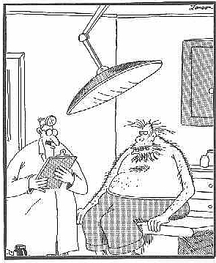
Pituitary disorders
Well, Mr. Rosenburg, your lab results look
Pretty good – although I might suggest your
Testosterone level is a tad high

Slide 40
Hyperfunction
Usually caused by tumour
Prolactin: commonest
  Galactorrhoea (abnormal lactation – females)
  Amenorrhoea – lack of periods
  Infertility
Treated with dopamine agonist
  May also shrink tumour

Slide 41
Hyperfunction (cont^{d})
ADH: syndrome of inappropriate ADH secretion (nonpituitary causes)
Acromegaly: growth hormone
Cushings syndrome:
  Pituitary ACTH excess (Cushing’s disease)
  Ectopic ACTH (lung tumour etc)
  Adrenal Cortisol excess
TSH, LH, FSH, oxytocin: exceedingly rare

Slide 42
Hypofunction
Any hormone except prolactin, oxytocin (no recognised clinical syndrome)
Range from mild (GH) to lethal (ACTH)
Causes: tumour, trauma, infection, developmental etc
May be combined: panhypopituitarism

Slide 43
Mass effects
Enlarge upwards
Headache often absent
Impingement on optic chiasm
Bitemporal hemianopia
Cranial N effects, hydrocephalus
Hypopituitarism
Hyperprolactinaemia – mild
  Due to stalk compression/disruption
Diabetes insipidus (suprasellar)

Slide 44
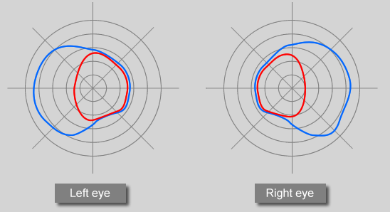
Visual fields – bitemporal hemianopia

Slide 45
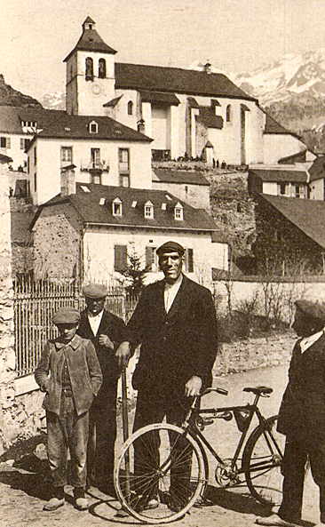
Acromegaly
Don Fermin y Urieta (1870-1913)
“The Giant of Aragorn”
229 cm tall

Slide 46
Acromegaly
Growth hormone excess in adults
  Usually sporadic
Children: gigantism
  50% due to mutation – AIP, GPR101
Often not recognised for 10-20 years in adults
Linear bone growth not possible after fusion of epiphyses

Slide 47
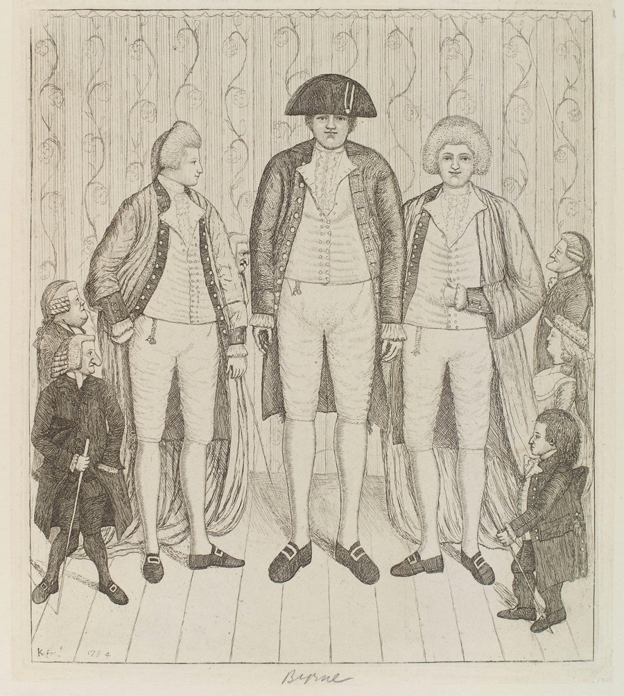
Charles Byrne (1761–1783) and the “giant” Knipe brothers

Slide 48
Growth hormone release
Acromegaly
Normal
06:00
12:00
18:00
24:00
06:00

Slide 49
Clinical features
Increase in ring, shoe, glove, hat size
Increase in size of nose, lips, soft tissue of face, tongue, jaw (prognathism) → coarsening
Deep cavernous voice
Fleshy, enlarged hands and feet
↑ metabolic rate: sweating, warm skin
Skin tags
Joint problems
Sleep apnoea

Slide 50
Metabolic/visceral features
Hypertension
Glucose intolerance
Cardiac enlargement, failure
Enlargement of liver, spleen, kidneys, thyroid, adrenal
Mortality increased
  72% increased over general population
  Reduction in survival ≤ 10y
  Reduced by surgery

Slide 51
Diagnosis
Characteristic appearance
Screening programs
Sleep apnoea, skin tags
Raised IGF-1 – simplest test
Imaging: MRI pituitary

Slide 52
Treatment
Surgery: trans-sphenoidal
transfrontal
Somatostatin agonists
Radiotherapy – several years for effect
Dopamine agonists – Bromocriptine, Cabergoline (not very effective)

Slide 53
Summary
Case presentation: acromegaly
Structure and function:
  Anatomy
  Nerve, blood supply
Pituitary and hypothalamic hormones
  Anterior/posterior pituitary hormones
  Hypothalamic releasing hormones
Disorders of pituitary function
  Hyper/hypo-function
  Mass effects
Acromegaly
  Hormonal, clinical features
  Treatment

Slide 54
The End

