Slide 1
Prolactinomas: when to withdraw treatment
Robert Schmidli

Slide 2
Outline
Case histories
Practice audit
Pituitary macroadenoma
Menopause
Post-pregnancy

Slide 3
Case studies
Case 1

Slide 5
Case 1
Presented November 2000
35-year old computer programmer
4/12 burning L breast
Noted by chiropractor that L breast more prominent
Shaves daily
Normal libido & early morning erections
No medications
Sister had microprolactinoma

Slide 6
Examination
Appeared well. No endocrinopathy
Weight 91.6kg
BP 116/70
Slight increase SC tissue L breast, no convincing breast tissue
Normal male hair distribution
Testicular volume 20m bilat
Clinically euthyroid
CVS, resp, GI systems normal
Fundi: deep physiological cups
Visual fields normal

Slide 7
Investigations
Renal function Normal
β-HCG <2 U/L
TSH 1.35mIU/L
LH 1.2U/L
FSH 1.9U/L
Estradiol <100pmol/L
Testosterone 11.7nmol/L
Prolactin >150μg/L [N <17]

Slide 9
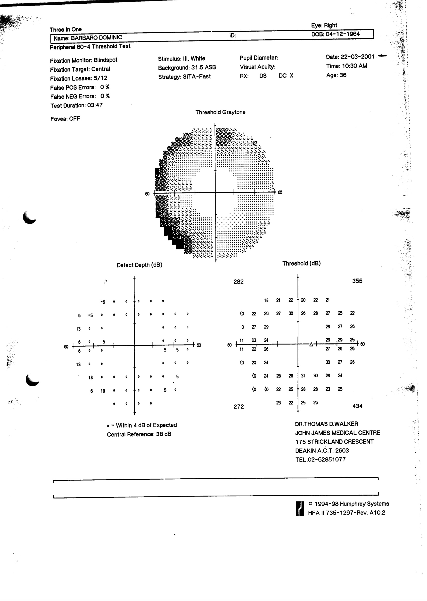
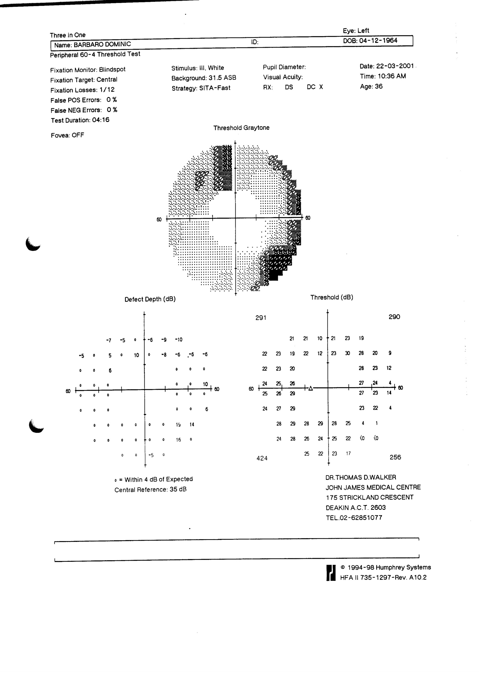

Slide 10
Progress
Feb 2001
Bromocriptine – dose titrated to 30mg/day
Prolactin persistently >150μg/L
Discussed/seen by P McNeill, J Fuller, K Ho
MRI – “Excellent response to Bromocriptine … Prolactinoma gland entirely within pituitary gland”. Suggestion haemorrhagic change
June 2001
Prolactin 88μg/L
Visual fields improved (April)
August 2001
Hair loss (Bromocriptine - NEJM)
Further haemorrhage on MRI

Slide 11
Further progress
Marked weight loss – CT abdomen, endoscopy → no explanation
December 2004
No discrete mass lesion on MRI
Prolactin normal
Bromocriptine tapered
Sister diagnosed with microprolactinoma
Ca⁺⁺, PTH normal
February 2006
Normal sized pituitary on MRI
Further tapering bromocriptine

Slide 12
Progress - continued
June 2010
Bromocriptine 5mg daily
April 2012
Referred haematology – thrombocytopenia & neutropenia
February 2013
Diagnosed hairy cell leukaemia. Rx Cladribine
Follow-up marrow showed complete remission
2014
Fatigue – diagnosed with obstructive sleep apnoea

Slide 13
Progress - continued
March 2017
Bromocriptine 2.5mg 5/7 days
Prolactin 281mIU/L
Fatigue
Stopped Bromocriptine
April 2017
Prolactin 236mIU/L
February 2018
MRI – “Unchanged pituitary appearances. No evidence of tumour recurrence”
March 2021
MRI unchanged: “The sella is expanded. There is some residual pituitary tissue seen posteriorly and on the right.”
April 2023
Prolactin 175mIU/L

Slide 14
Case 2

Slide 15
Case 2
26-year-old man
2002: Referred by ophthalmologist with field defect
Problem with R eye 4y before presentation
Reassured normal by optometrist
“Unable to see out of corner of eye”
Passed driver’s licence
CT: large pituitary adenoma 23 x 40mm
Compression & elevation of chiasm
Scanty body hair, shaves every few months
Rather high pitched voice
Reduced libido, some early morning erections

Slide 16
Examination
Appeared young for years
Rather high-pitched voice
BP 104/76 104/82
Sparse facial hair
Reduced body hair
Pubic hair, penis Tanner 4
R field – upper nasal only, temporal defect L
Pale optic discs

Slide 17
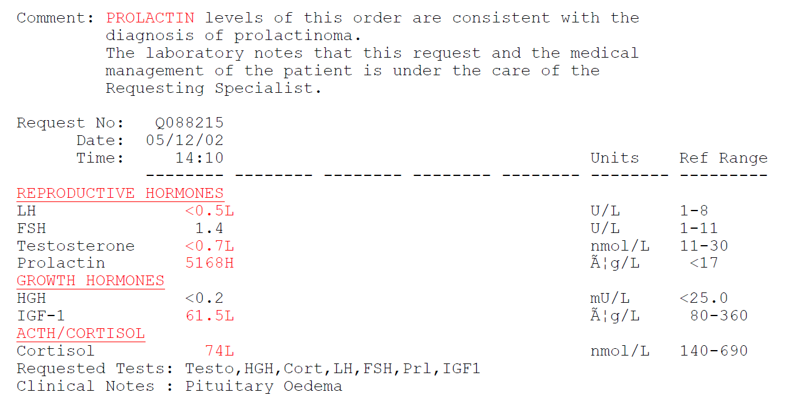
Investigations

Slide 18
Treatment
Cortisone acetate 15 + 10mg
Cabergoline 0.5mg weekly → twice weekly → 5 per week
Thyroxine 50μg daily (after Cortisone)
Sustanon 250mg 3-weekly

Slide 19
Progress
2006
Cabergoline 0.5mg twice a week
Cortisone acetate, thyroxine, Sustanon → Testogel
No evidence of tumour on MRI
Hand movement R, normal fields on L
2014
Not seen since 2010
18 month old child, partner had miscarriage
Cabergoline 1 per week

Slide 20
Progress
2016
Semen analysis: 170, 15 x 10⁶/ml [Normal >39]
2017
Pregnyl injections – wife 6wk pregnant
Cabergoline 0.5mg weekly
2023
Not seen since 2018
Stopped all medications
Poor libido, fatigue, reduced motivation, exhaustion after work

Slide 21
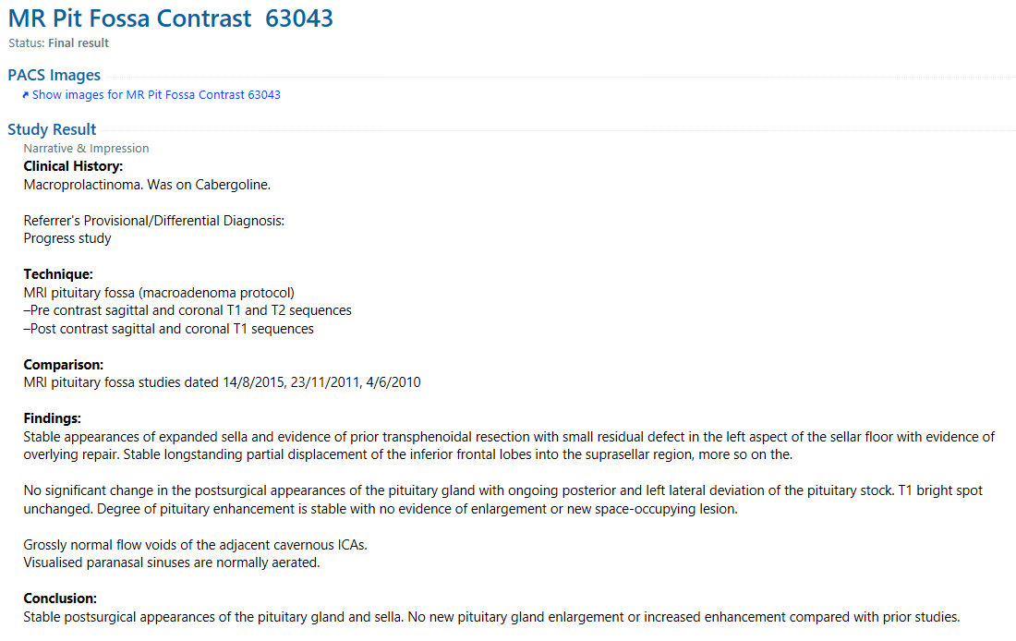
MRI pituitary 3 April 2023

Slide 22
Investigations - 2023
Prolactin 248mIU/L
Testosterone <0.3nmol/L
Cortisol 90nmol/L
FT4 7.9pmol/L
IGF-1 3nmol/L
Peak GH (glucagon) <0.2μg/L
Na+, K+ normal

Slide 23
No | Age, year present-ation, sex | Max tumour size (mm) | Initial Prolactin | Year Rx Ceased | Latest MRI | Latest Prolactin (mIU/L) | Visual fields
1 | 35, 2000, M DB | 28mm | >150μg/L | 2017 | No evidence of tumour | 175 | Normal
2 | 26, 2002 M ADS | 40 | 5169μg/L | ~2018 | Small defect L aspect sellar floor | 248 | Hand mvt R Normal L
3 | 42, 1994 M AG | ? | ? | 2016 | Cystic mass | 163 | Normal
4 | 54, 2010 M CH | 20 | 31,000mIU/L | 2020 | No tumour | 491* | Not typical
5 | 25, 2015 M CL | 11 | 8080mIU/L | 2020 | Subtle region delayed enhancement on ant/inferior aspect of the gland | 514* | N/A
6 | 72, 2013 F DG | 29 | >42000mU/L | 2019 | No tumour | 117 | Normal
7 | 40, 2011 M SM | 10 | 10680mu/L | 2020 | Non-enhancing region L hemi pituitary 10x5x5mm. Stable | 325 | N/A

Slide 24
Hazards of Cabergoline

Slide 25
Cardiac valve abnormalities
Potent agonist of 5-hydroxytryptamine 2B (5-HT2B) receptor expressed on heart valves (Bromocriptine antagonist)
→ mitogenic effect on cardiac fibromyoblasts
UK GP Research Database
11,417 patients 40-80y on anti-Parkinson drugs 1988-2005
1228 on Cabergoline
Results
6 exposed to Cabergoline
19 no dopamine agonist
Incidence-rate ratio 4.9 (95% CI 1.5-15.6) for Cabergoline
Elevated for >3mg daily Cabergoline

Slide 26
Recommendations
Cabergoline safe with cumulative dose of 300 - 4000mg
4000mg = 1mg weekly for 80 years
History & exam only if ≤2mg/week [Gamble et al Ther Adv Drug Safety]

Slide 27
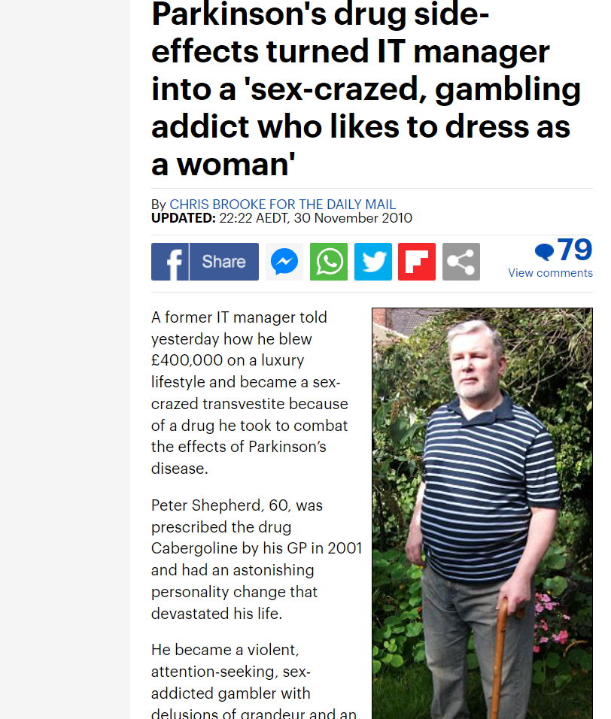
Impulse control disorder (ICD)

Slide 28
Impulse control disorder
Interaction with D3 receptors in mesolimbic system
Controls pleasure, behaviour, addiction
23% compulsive eating in pts treated for restless legs
Occurs in 8-25% prolactinoma patients
Not dependent on dose (?), duration, prior psych disorder
Can occur with any DA agonist
Described in acromegaly on Da agonist

Slide 29
Cross-sectional study, 308 patients
Prevalence 17% overall
Hypersexuality M > F
Compulsive eating F > M
JCEM 104: 2527, 2019

Slide 30
Withdrawal of treatment

Slide 31
Guidelines
Pituitary Society (Clin endocrinol 2006; 65: 265)
Reduce dose when prolactin normal
Minimum duration therapy 1 year
Consider if duration ≥3yr if tumour markedly reduced
Endocrine Society (JCEM 2011; 96: 273)
Safe after 2y if normoprolactinaemia & significant tumour vol reduction
Monitor prolactin 3-monthly first year then annually
May be withdrawn after menopause
NIDDK:
Microadenomas – normalisation of prolactin & shrinkage
Treatment can be withdrawn after 2y if prolactin normal & tumour not visible

Slide 33
Methods
Patients (n=200)
25 non-tumoural hyperprolactinaemia
105 microprolactinomas
70 macroprolactinomas
Criteria for withdrawal
Prolactin levels normal
MRI
No tumour
Reduction ≥ 50%
>5mm from chiasm
24-month follow-up possible

Slide 34
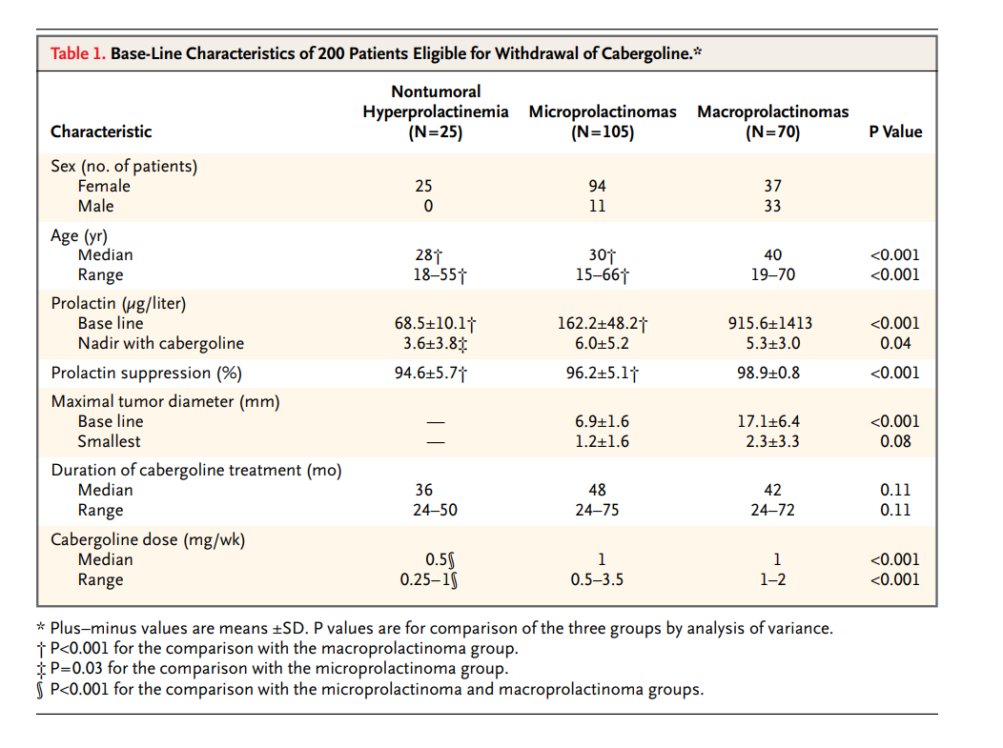

Slide 35
Results
Recurrence rates
24% non-tumoral
31% microprolactinomas
36% macroprolactinomas
No renewed tumour regrowth
Recurrence hypogonadism 22% ♀, 39% ♂
Recurrence rate higher
Macro cf microprolactinomas
Residual tumour before withdrawal vs no residual

Slide 36
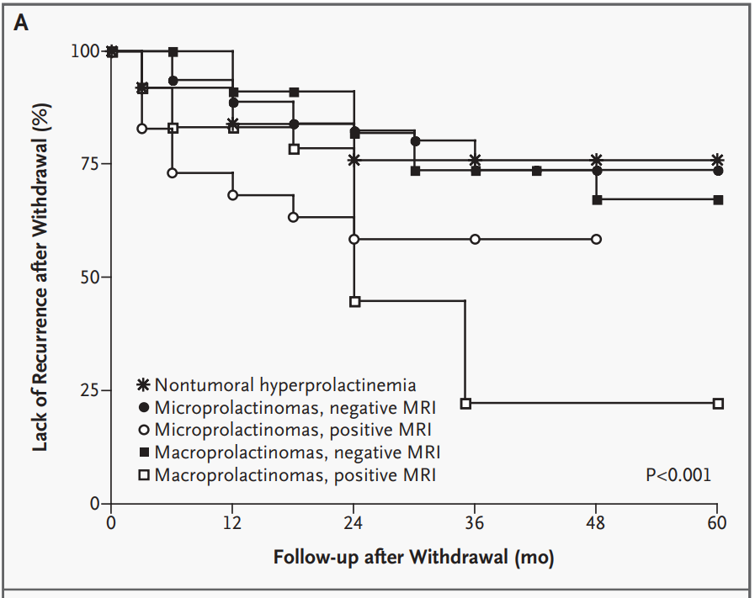

Slide 37
Menopause
Endocrine society – may be discontinued at menopause
Little data on natural history after menopause

Slide 38
Impact of menopause on outcomes in prolactinomas after dopamine agonist treatment withdrawal Santharam S et al. Clin Endocrinol 2018; 89: 346
Patients
Patient recruited between 2000 & 2017 from single UK centre
Median 3y follow-up
Controls: women with prolactinomas; treatment discontinued before menopause (n = 28)
Study group: diagnosed before menopause, off therapy after menopause (n = 30). 28 stopped Rx peri- or post-menopause (6 macro), 2 not treated (micro)
Results - prolactin levels
Menopausal group: Increased 15%, decreased, not normal 33%, normal 52%
2 had tumour regrowth
Controls: 20/28 (71%) became hyperprolactinaemic
HR lower in postmenopausal group – 0.316 (P , 0.05) – corrected for tumour size at diagnosis, treatment duration, adenoma at time of withdrawal

Slide 39
Pregnancy

Slide 40
Ampudia X et al. Eur J Obs Gyn Repo Biol. 1992; 46: 101
N = 24, 16 had tumour, 2 empty sella
Mean prolactin
Basal 95 μg/L
1st pregnancy 38
2nd pregnancy 24
Laway B et al. Indian J Endocrinol Metab 2021; 25: 559
Retrospective study – 25 women with 31 pregnancies
20 micro, 11 macroprolactinomas, conceived on Cabergoline
DA agonist stopped during pregnancy in 24
Normal prolactin after pregnancy in 10 (41.6%)
42% adenoma size reduced to <50% original
Duration therapy before treatment
Remission: 60 months
No remission: 24 months
Predictors of remission: duration therapy, adenoma size, baseline prolactin

Slide 41
Treatment of prolactinomas
Choice of dopamine agonist
Resistant to bromocriptine – 79% normalised with cabergoline
Cabergoline → bromocriptine – some cases successes
Surgery
Microprolactinoma – normalised in 71-100%, recurrence 0-25%
Macroprolactinoma – 60% long-term remission
Giant prolactinoma – 0% remission after surgery
Carcinoma – higher risk if resistance to DA develops (rare)

Slide 42
Conclusions
Withdrawal of dopamine agonist is possible provided:
Adequate duration of treatment
Normal prolactin level
Absence of tumour on treatment
Long-term follow-up possible
Prolactin may normalise after pregnancy
Consider withdrawing treatment at menopause

