Slide 1
Thyroid disorders
Robert Schmidli
Senior Lecturer, ANU Medical School
Senior Staff Specialist, The Canberra Hospital
www.schmidli.com.au

Slide 2
Overview
Goitre
Hyperthyroidism
Hypothyroidism
Thyroid nodules
Thyroid cancer
Subclinical thyroid disease

Slide 3
Case 1
45 year old lady
Neck mass to right of midline
Present for years
Presented with unrelated complaint

Slide 4
History
No increase in size
No dysphagia
No stridor
No cough
No sensation of constriction on raising arms
“Nervousness”, reduced sleep

Slide 5
Examination
Rather overweight
Weight 109.4kg
Pulse 80 per minute regular
No tremor, thyroid eye signs
Skin warm
Thyroid generally enlarged
Retrosternal dullness
Large 3x2cm mass right of midline
Another smaller mass in left lobe
No lymphadenopathy
Pemberton’s sign negative

Slide 6
Thyroid function tests
FT4 20 pmol/l [normal]
TSH <0.005 mU/l [N 0.4-4.0]
FT3 8.5 pmol/l [N 3.5-6.0]

Slide 7
Investigations
Thyroid antibodies (Thyroglobulin, TPO)
TSH receptor antibody
Thyroglobulin
Neck ultrasound
Nuclear scan
Fine needle aspiration
CT thoracic inlet
Chest X-ray
Lung function tests

Slide 8
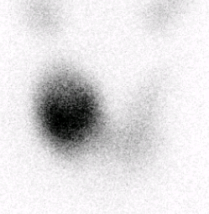
Technetium scan

Slide 9
Technetium scan
There is intense radiotracer uptake probably corresponding to the largest nodule measuring 3.2cm in the right lobe. Though, this does not completely suppress function in the contralateral left lobe, there is relatively reduced tracer uptake in the rest of the thyroid gland. There are no other discrete cold or hyperfunctioning nodules identified in the right or left lobe.
The thyroid uptake ratio was however measuring within the normal range at 2.4% (normally 0.4 - 4.7%).

Slide 10
Ultrasound
Report
There is moderate thyromegaly with a total volume of 38cc (upper limit of normal for an adult female being 12cc). The right lobe measures 27.6cc, the left 10.6cc. There is no retrosternal extension nor significant tracheal deviation.
Multiple colloid nodules are present bilaterally in keeping with a multinodular goitre. The largest nodule is on the right and measures 32mm in maximal dimension. This is well defined with areas of colloid and foci of ring down artefact characteristic of a colloid nodule. There is posterior acoustic enhancement suggesting a history of haemorrhage.
There is a focus of coarse calcification in an isthmic nodule, usually
considered benign.
No suspicious lesion is identified. There is no neck mass nor
lymphadenopathy.

Slide 11
Treatment
“Wait and see”
Antithyroid drugs
Radioactive iodine
Thyroxine suppression
Lugol’s iodine drops
Total/partial thyroidectomy

Slide 12
Radioactive iodine
Ablates hyperactive nodule without affecting “cold” areas
Hypothyroidism uncommon
Safe, convenient, single dose
Long-term control without medication requirement

Slide 13
Alternative medicine
Biotin – substrate in assays
↑ FT3, FT4, TRAB
↓ TSH
Iodine – Lugol’s iodine, contrast media
Aggravation of hyperthyroidism with toxic nodule
Acute hypothyroidism
Jod-Basedow phenomenon

Slide 14
Case 2
24 year old lady
Presented to Calvary Hospital with tachycardia
ECG ?WPW
Heat intolerance, 1kg weight loss
Medications: OCP

Slide 15
Examination
Anxious
Systolic murmur
Tremor
No eye signs

Slide 16
Investigations
T4 38
T3 14
TSH < 0.04
Thyroid AB negative
Receptor antibody negative
Further investigations?

Slide 17
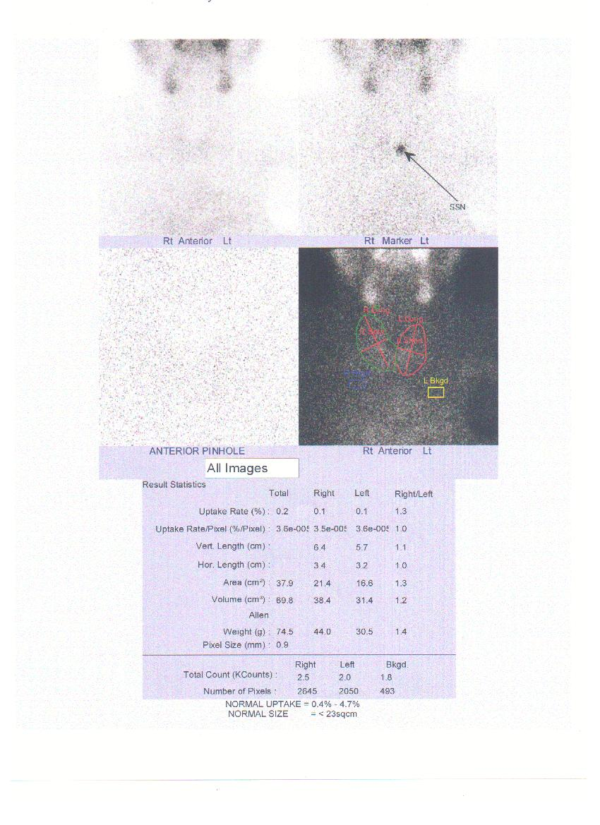

Slide 18
Thyroiditis - causes
Postpartum
Post-viral
Drugs
Amiodarone
Interferons
Tyrosine kinase inhibitors
Autoimmune – Hashimoto’s
May be preceded by thyrotoxicosis
Radiation
Idiopathic

Slide 19
Thyroiditis - clinical
Usually painless
May have raised CRP, ESR
Treatment
Beta-blockers
Steroids if painful
Course
Spontaneous resolution
May progress to hypothyroidism – transient or permanent

Slide 20
Case 3
30 year-old student
Type 1 diabetes – regular visit
Tremulous voice
Warm sweaty skin, tremor
Diffuse goitre
Pulse 100/m

Slide 21
Symptoms
Tremor
Muscle weakness
Palpitations
Sweaty
Heat intolerance
↑ frequency bowel motions
Light periods
Eye irritation

Slide 22
Examination
Tachycardia
Warm skin
Tremor
Brisk reflexes
Proximal weakness
Diffusely enlarged thyroid, bruit
Conjunctivitis

Slide 23
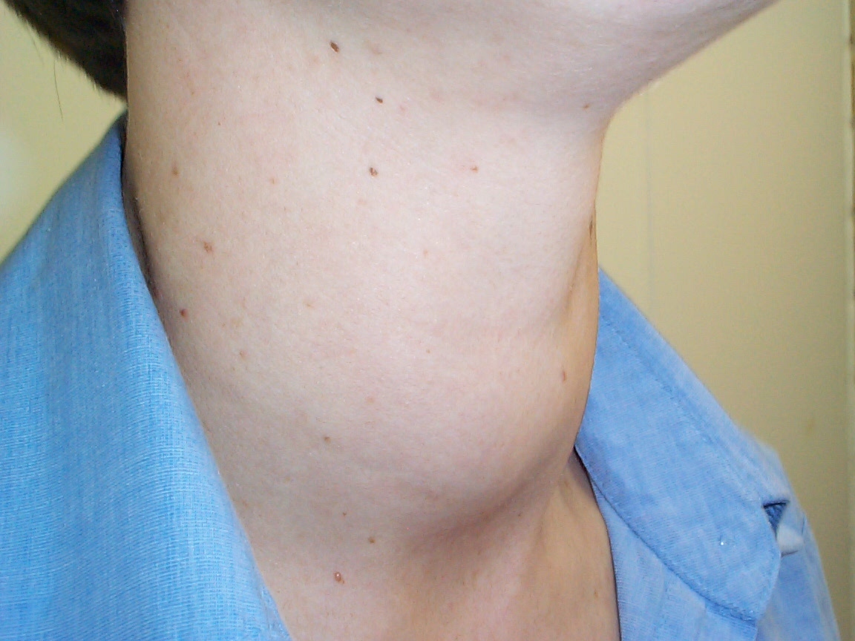

Slide 24
Investigations
FT4 53.8 nmol/l [10-24]
FT3 36.1 pmol/l [4.3-8.1]
TSH <0.03 mU/l [0.4-4.0]
TGAb <20 U/ml [<40]
TPOAb 21.0 [<35]
TRAB 22 U/l [<10]

Slide 25
Imaging
None required
Thyroid ultrasound
Nuclear scan

Slide 26
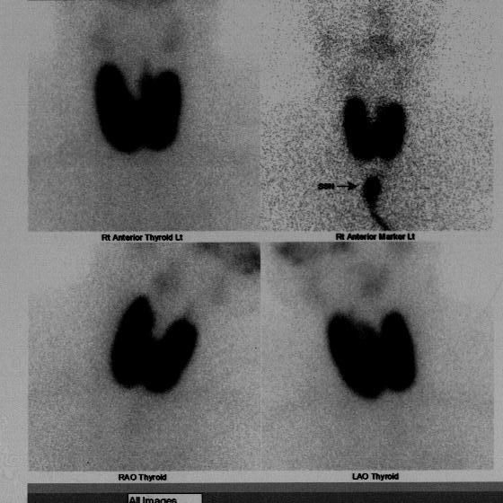

Slide 27
Nuclear scan
There is a uniform increase in tracer uptake throughout the gland with an uptake ratio of 9.1% (normal 0.75-4.5). The frontal area of the gland is normal.

Slide 28
Treatment options
Antithyroid drugs
Radioactive iodine
Complete ablation
Partial ablation
Partial thyroidectomy
Total thyroidectomy

Slide 29
Graves’ disease - treatment
Antithyroid drugs
Carbimazole
Propylthiouracil
AEs – agranulocytosis, liver, rash
Treat 12-18 months
Remission usually occurs <1y
May recur – approx. 50% risk
¹³¹I ablation or total thyroidectomy if recurrent
Requires permanent Thyroxine

Slide 30
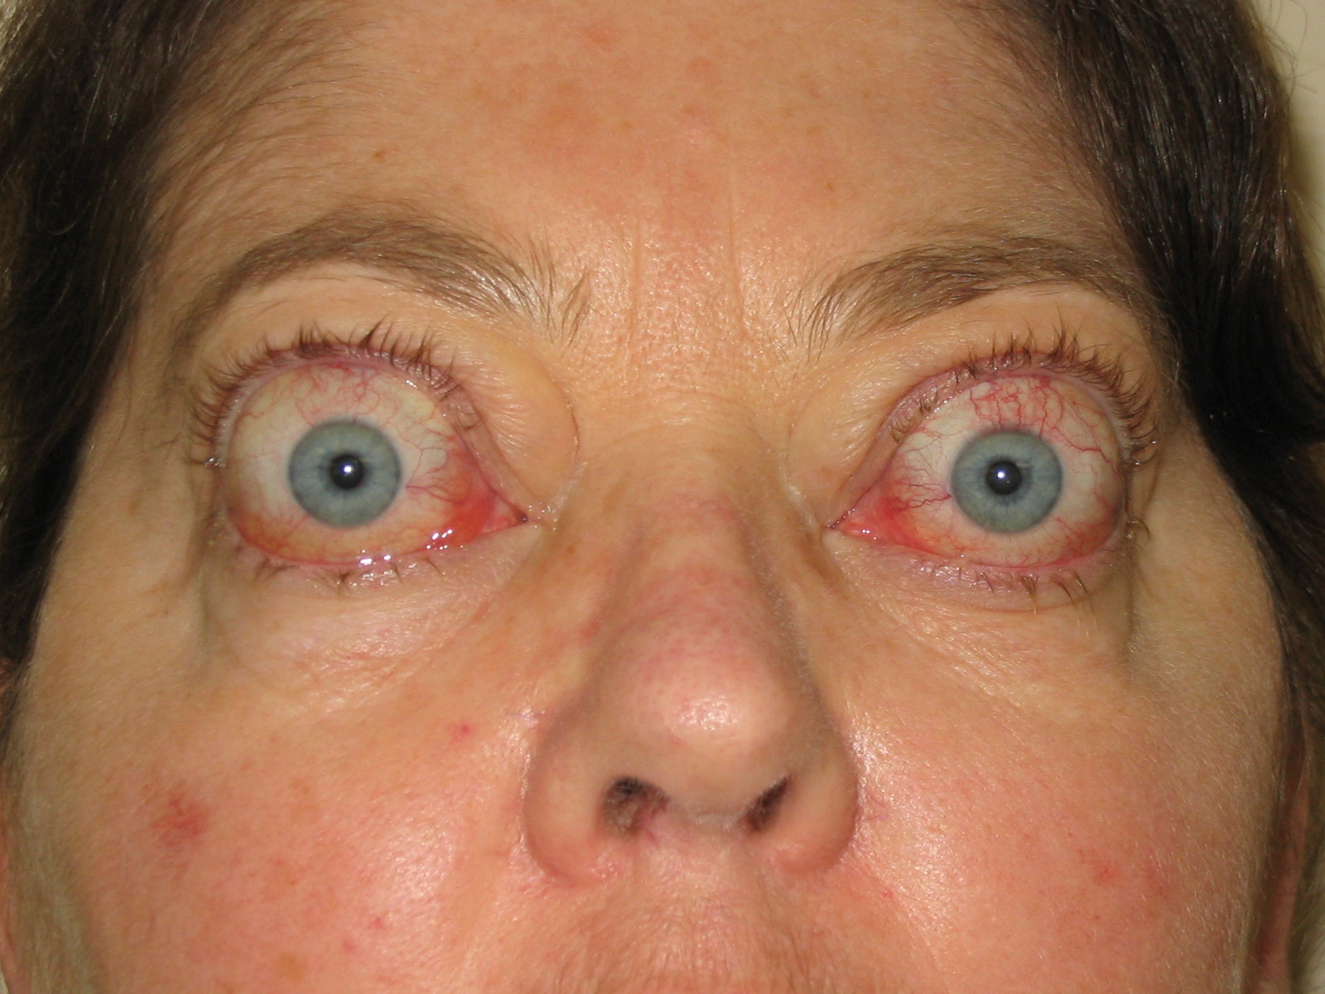

Slide 32
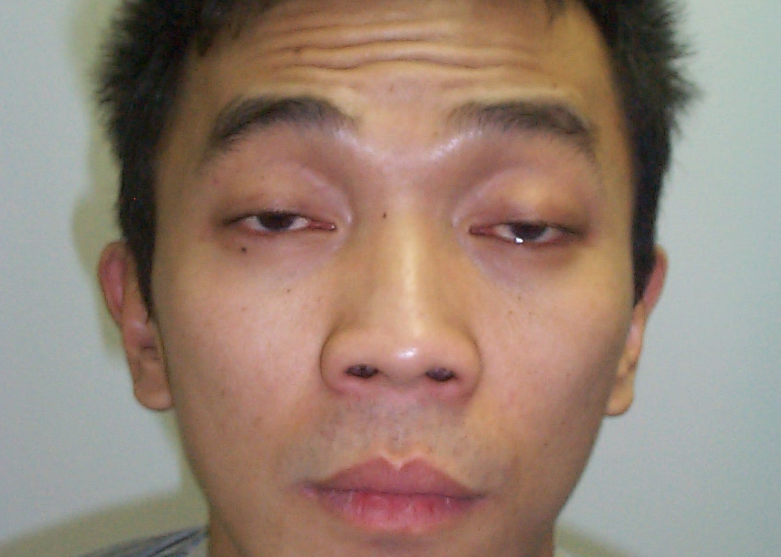

Slide 33
Case 4
35 year old female
Hypertension – 160/90
Follicular thyroid carcinoma at 25
Total thyroidectomy, 131I
Followed up by endocrinologist until 30y
On Thyroxine 175mcg daily
GP follow-up thereafter
Examination otherwise normal
Investigations?

Slide 34
Investigations
TFT normal
TSH 3.5mU/l
Investigation for secondary hypertension negative

Slide 35
Progress
Treated for hypertension
Repeat scripts
Annual TFT normal

Slide 36
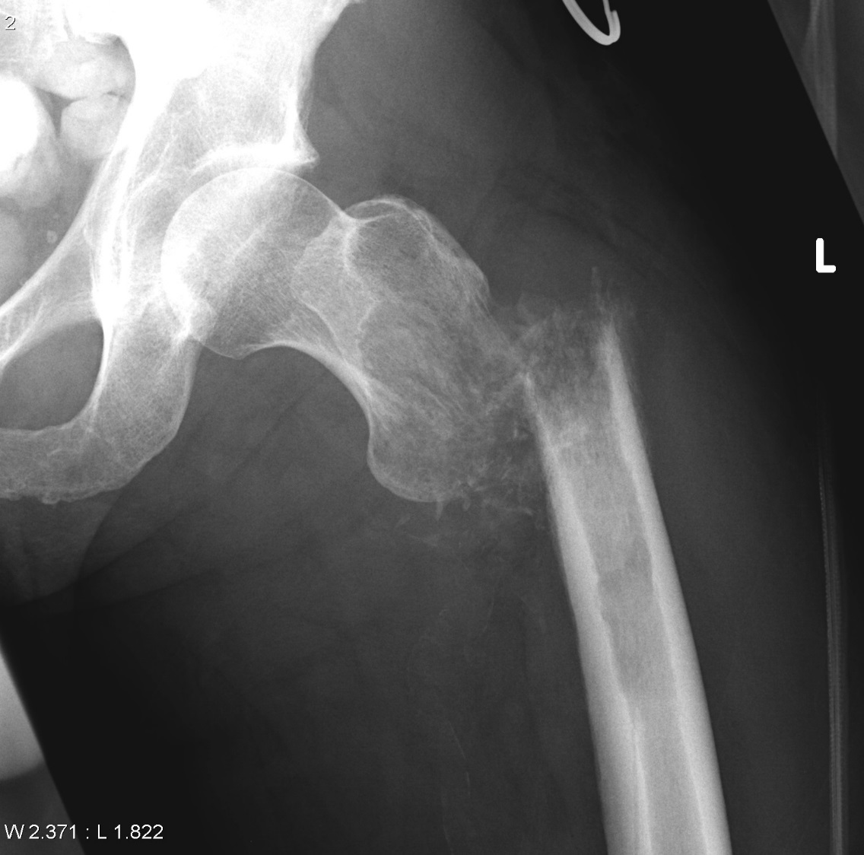
Presents two years later with fracture of femur after minimal trauma

Slide 37
Thyroid cancer: Common presentations
Lump in neck
Radiological incidental finding
Ultrasound
CT
MRI
PET scan
Incidental finding at surgery

Slide 38
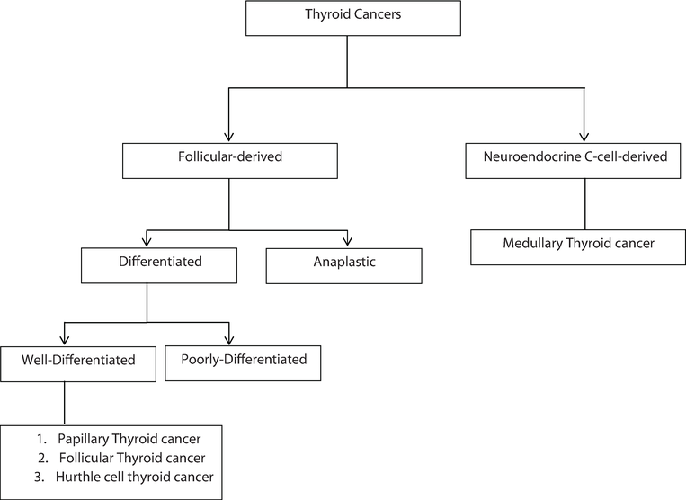
https://www.intechopen.com/books/diagnosis-and-management-of-head-and-neck-cancer/thyroid-cancers-considerations-classifications-and-managements

Slide 39
Initial management of differentiated thyroid cancer
Total thyroidectomy ± neck dissection
Microcarcinoma (<1cm) – partial
High-dose ¹³¹I ablation
Dependent on risk level
Recombinant TSH or Thyroxine withdrawal
Aim for undetectable Thyroglobulin
Stimulated Thyroglobulin
Move towards less aggressive management

Slide 40
Long-term follow-up of differentiated thyroid cancer
Late recurrences may occur
Annual physical examination
TSH – aim for suppression – duration depends on risk
Thyroglobulin
Measure of thyroid tissue in body
Should be undetectable after surgery/¹³¹I
Thyroglobulin antibody
Can interfere with Thyroglobulin
1-5 yearly thyroid ultrasound

Slide 41
Overdiagnosis of thyroid cancer
Diagnosis tripled in USA last 30y
Little change in some developed countries
Mortality unchanged over last 35y
Usually good prognosis
Papillary cancer, nodules <20 mm: 99% alive 20y
Small pulmonary mets, nil outside neck: 10y survival 30-50%
Some primaries (<1cm), involved nodes may be watched without intervention

Slide 42
Investigation of thyroid nodules
Examination/history
Thyroid function
Nuclear scan if low TSH
Ultrasound
Fine needle aspiration if suspicious
Total/partial thyroidectomy if FNA suspicious

Slide 43
Ultrasound
Increased risk
Hypoechoic
Microcalcification
Central vascularity
Irregular margin
Taller than wide
Enlarging
Reduced risk
<1cm (don’t FNA)
Hyperechoic
Coarse calcification
Periph vascularity
Spongiform
“Comet tail”
Requires experienced radiologist!

Slide 44
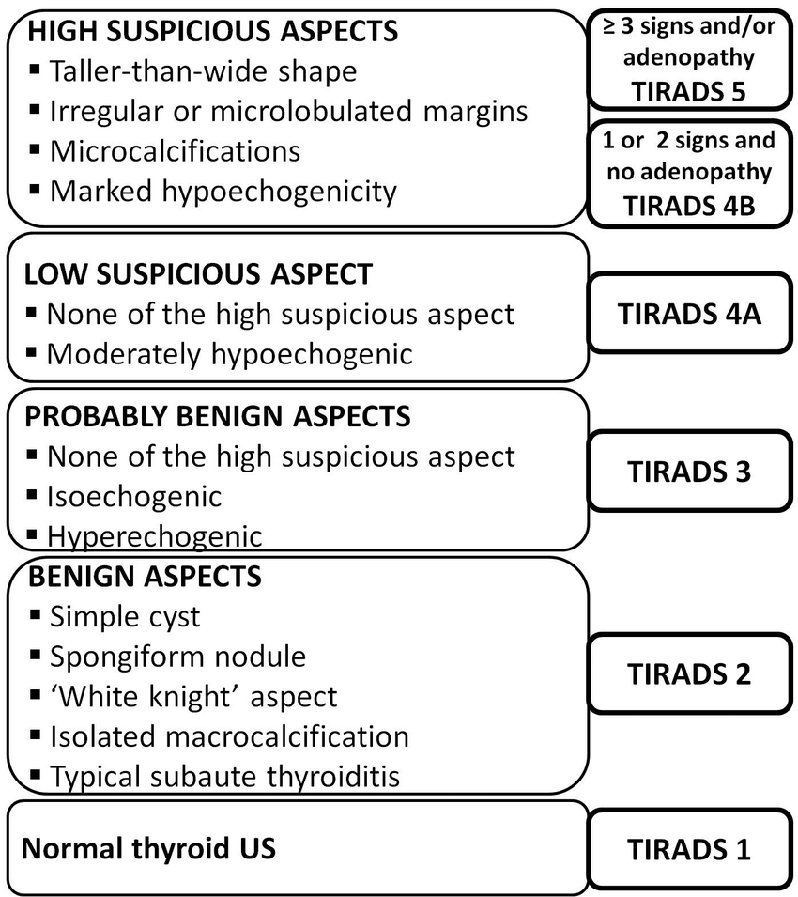
TIRADS Grading
Thyroid
Imaging
Reporting and
Data
Systems
researchgate.net

Slide 45
Adverse prognostic features
Adverse prognostic features
Age > 45y (esp with nodal involvement)
Male gender
Large tumours (eg. 20y mortality 50% for >7cm)
Soft tissue invasion
Distant metastases
Histological features eg. Hurthle cell, tall cell

Slide 46
Indications for neck ultrasound
Suspicion of thyroid cancer
Clinical lump in neck
Goitre (may be large nodule)
Nodule on other imaging modality
Symptoms suggestive of neck mass
Cold nodules on nuclear scan (not necessarily high risk)

Slide 47
Case 5
25 y/o lady
Weight gain 8kg over 6 months
Fatigue
Constipation
Dry skin

Slide 48
Examination
Pulse 60/min
Swollen face
Dry cool skin
Slow-relaxing reflexes

Slide 49
Investigations
TSH 150 U/l [0.5-4.4]
FT4 2 pmol/l [8.2-22]
Anti-TPO 300IU/ml [<35]
Anti-Thyroglobulin 1609 [<116]
Ultrasound
Thyroid is diffusely hypoechoic with echogenic areas suggestive of Hashimoto’s thyroiditis

Slide 50
Treatment
Thyroxine 150mcg/day
Can be started on full dose in young pt
Wait 6wk before re-testing
Annual follow-up when stable

Slide 51
Other points
Steady state reached 6wk after dose change
Pregnancy
Requirements increase (protein binding)
Associated with reduced IQ
Can be followed if TSH <10, normal T4, non-pregnant
Thyroxine absorption affected by food, iron, calcium supplements
Don’t do ultrasound unless thyroid mass

Slide 52
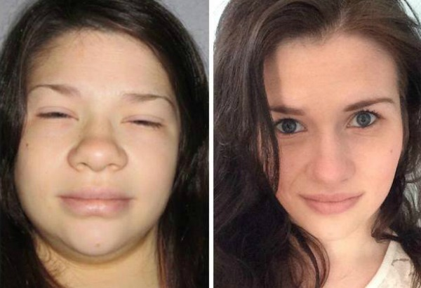
Credit: hypothyroidmom.com

Slide 53
Subclinical thyroid disease

Slide 54
Subclinical hypothyroidism
High TSH in presence of normal FT4
Prevalence 4-15%
Most autoimmune (Hashimoto’s)
2-4% progress to overt hypothyroidism per year
TSH < 10: no consistent benefit of treatment
Higher TSH target in elderly (eg. 6)
Repeat 6/12 then annually (Up ToDate)
Treat if pregnant, pre-pregnant
Recent guideline – no benefit for all TSH levels

Slide 55
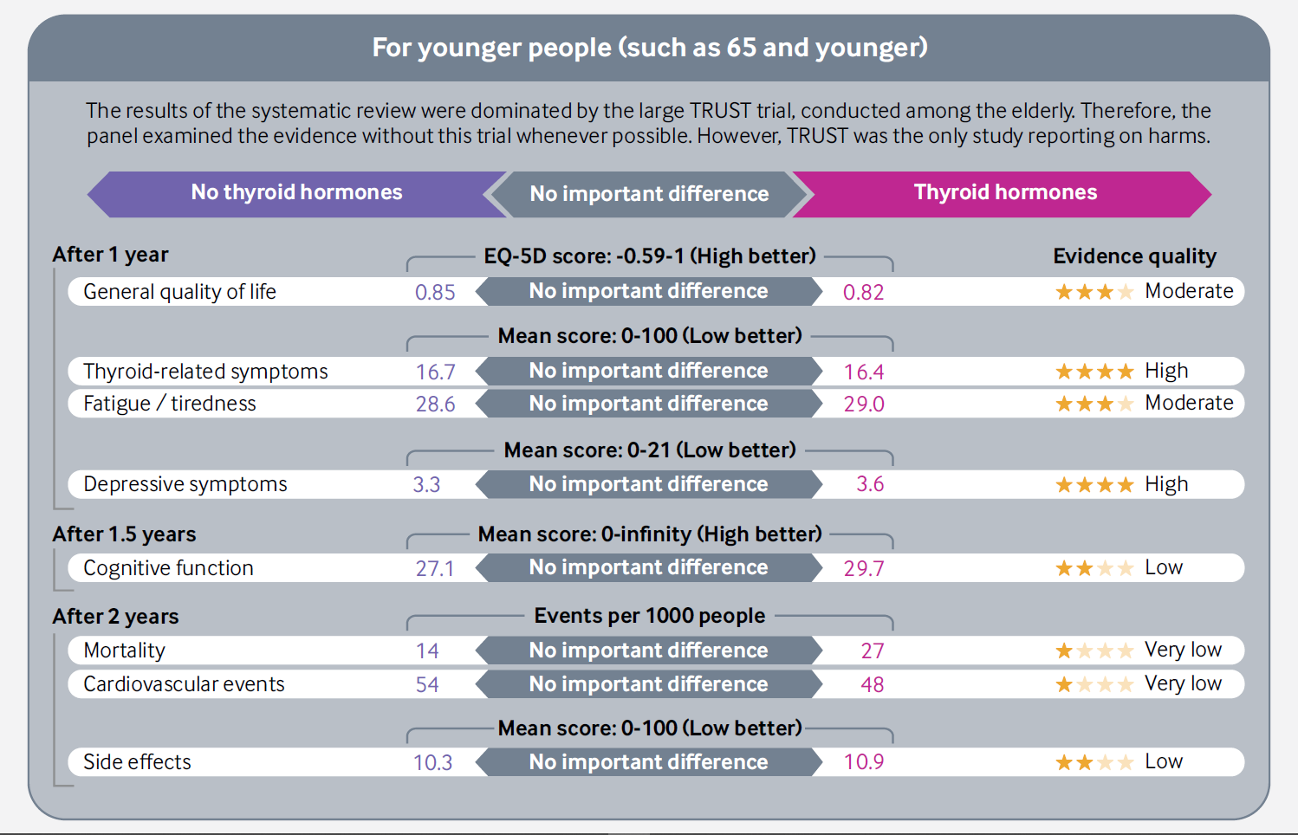

Slide 56
Subclinical hyperthyroidism
Low TSH with normal FT3, FT4
Causes
Toxic multinodular goitre
Early Graves’
Long-term complications
Atrial fibrillation/tachyarrhythmias
Osteoporosis
Treatment beneficial if TSH < 0.1mU/l – especially in elderly

Slide 57
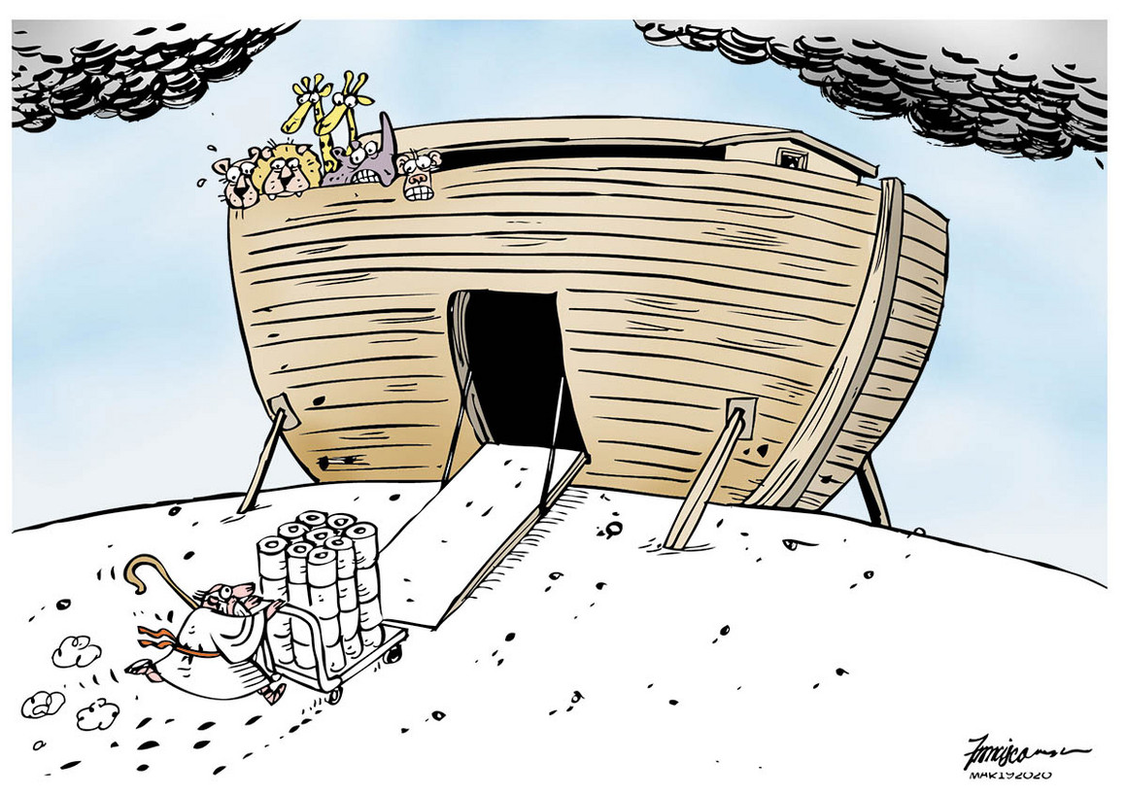
THE END

